Slide 1
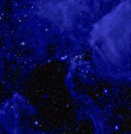
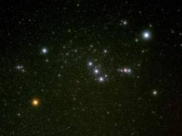
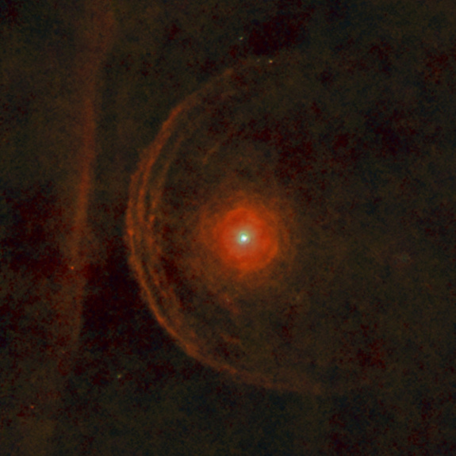
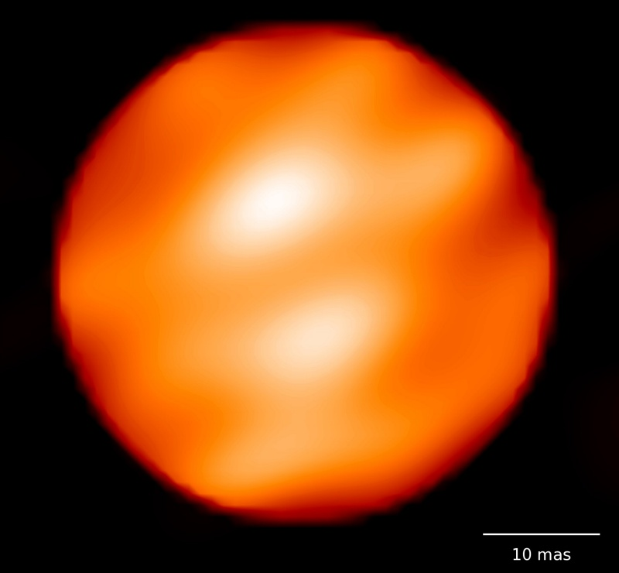
The Betelgeuse Project
J. Craig Wheeler
Department of Astronomy
University of Texas at Austin
Cook's Branch Nature Conservancy October 6, 2013

Slide 2
The Betelgeuse Project
How frustrating to look up at this massive evolved red giant and not know what evolutionary state it is in and when it is going to blow!
How to peer inside?
Asteroseismology –
Just before it blows, Arnett says it will undergo violent dynamical, convective burning of oxygen, silicon.
That should make sonic waves. Detect them at the surface?
Goal: measure the mass, evolutionary state, rotation, magnetic effects.

Slide 3
The Betelgeuse Project
Problems:
Betelgeuse is VERY bright, saturates photometers. Use small telescopes?
Betelgeuse has a large, noisy, convective envelope, hard to detect a faint signal from inside.
Idea:
Start with a Betelgeuse “analog,” a supernova progenitor star that is further away, dimmer, and has no envelope.

Slide 4
Asteroseismology of Wolf-Rayet Stars
No WR stars in Kepler or Corot fields.
WR stars can be observed from the ground, many plenty bright.
Rob Robinson obtained some WR aperture photometry, but WR winds, nebulae, artificial variations if aperture shifts.
Lifan has a new toy: Chinese Antarctic Observatory, 6-month long dark, clear nights. Observe WR stars.
Some data is in the bag, awaiting reduction, analysis.

Slide 5
Asteroseismology of Wolf-Rayet Stars
What period, amplitude signal do we seek?
Wonderful new tool: The MESA code, Modules for Experiments in Stellar Astrophysics.
Computes stellar structure, evolution and has an asteroseismology module.
Mike Montgomery, the MESA asteroseismology expert, works in the office next to mine.
Who does the work? A wonderful team of undergraduates.

Slide 6
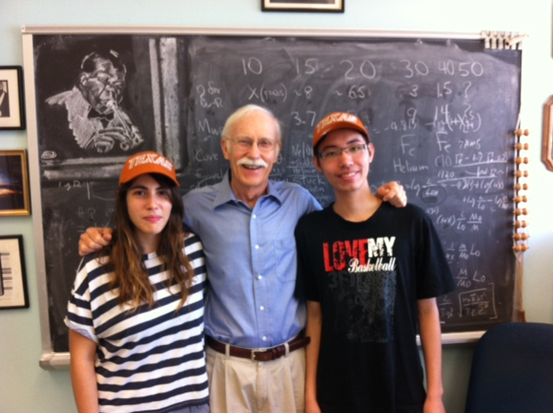
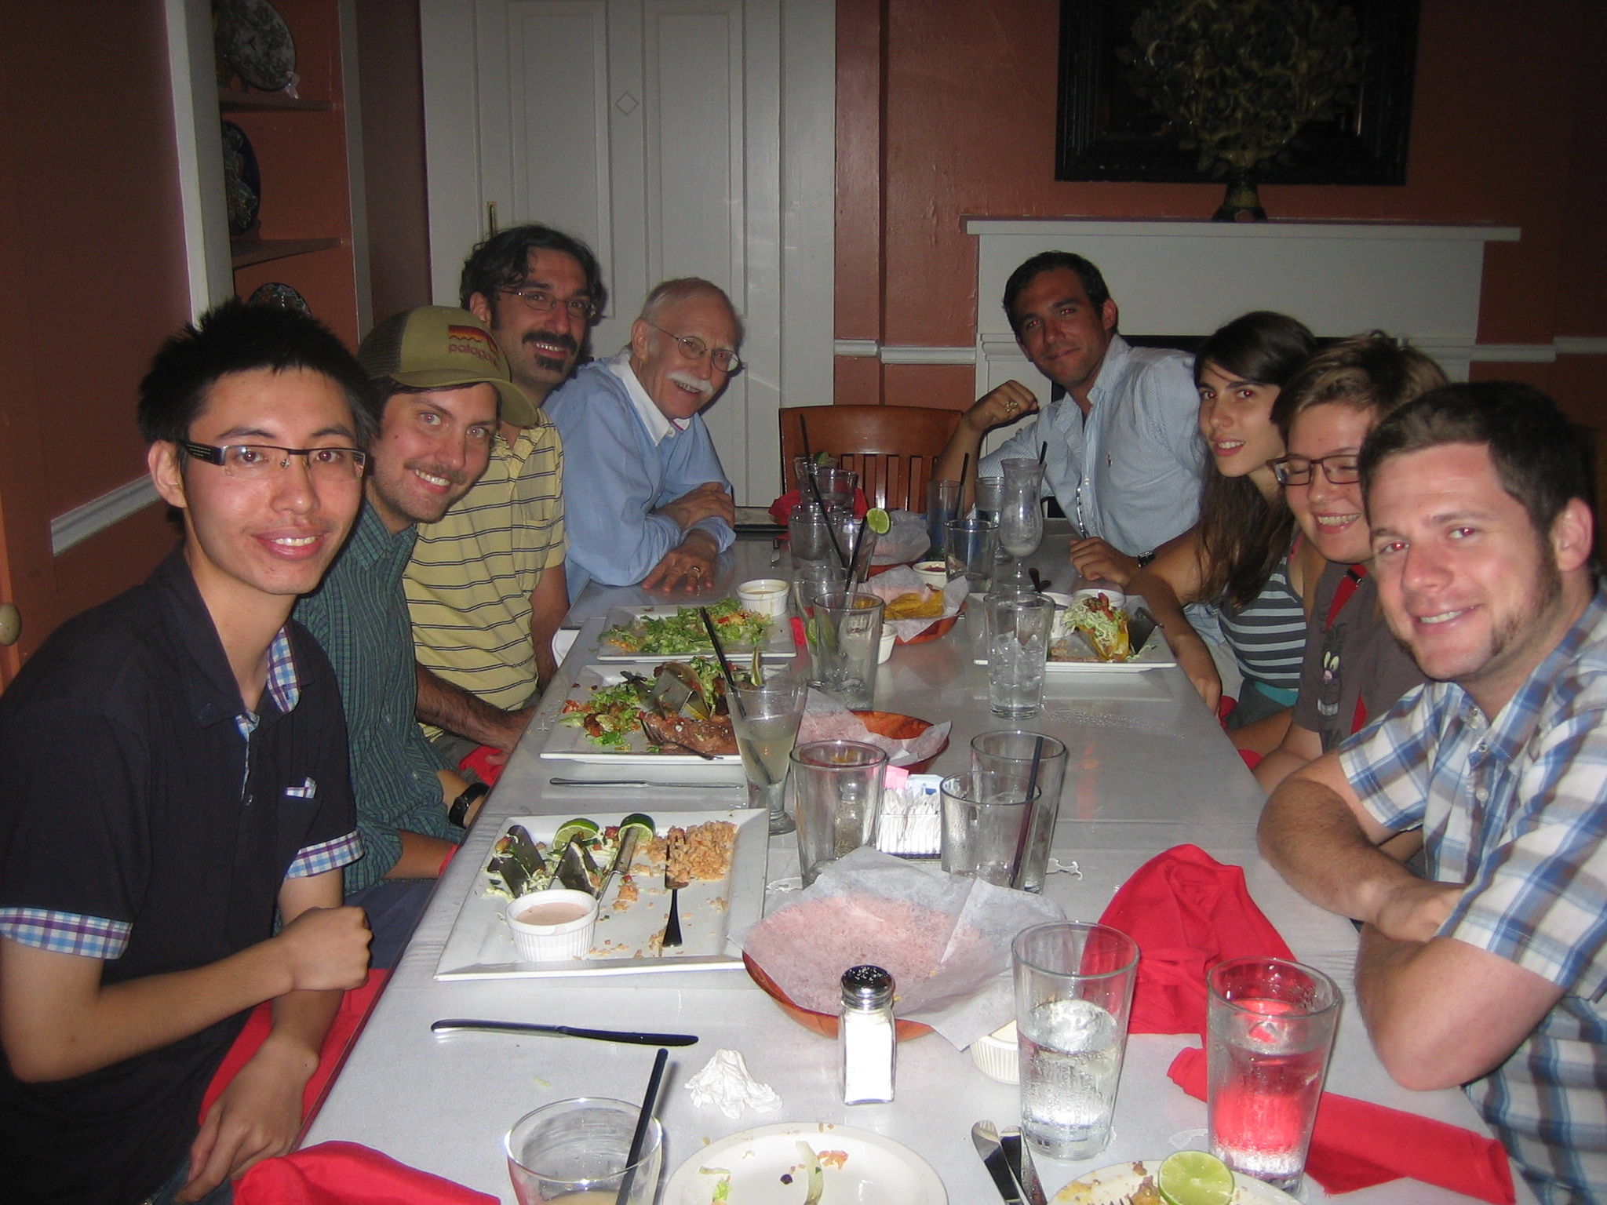
Steven Smith
Sarafina Nance
Julia Fowler
Justin Hickey
Maria Koutoulaki, Li Zhou

Slide 7
Asteroseismology of Wolf-Rayet Stars
Compute MESA models of massive stars, 15, 20, 30, 40, 50 M
Remove hydrogen envelope by winds or by hand after onset of core helium burning.
Identify convective regions that drive acoustic noise.
MESA can do rotating, magnetic models, to be done…

Slide 8
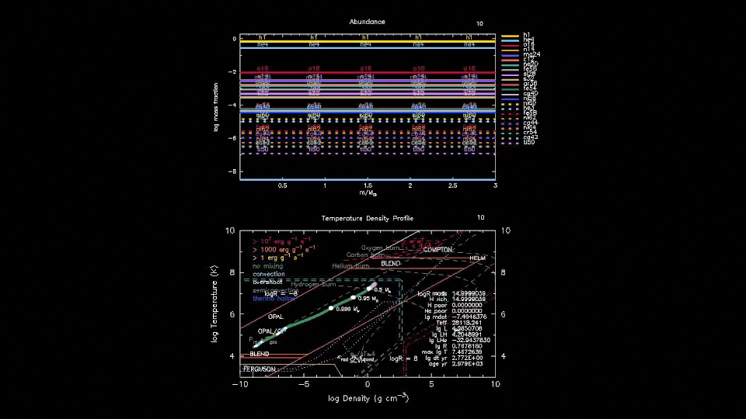
15 M enhanced mass loss

Slide 9
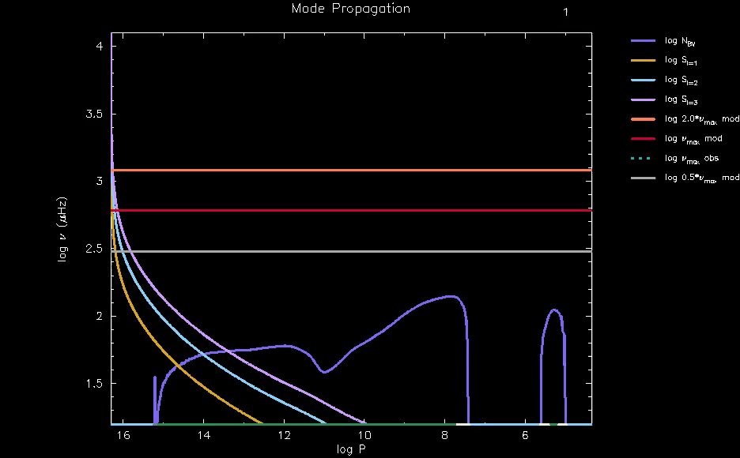
Propagation Diagram
Fundamental Mode Frequency
50 M
Lamb Frequencies
Brunt Väisälä Frequency

Slide 10
Critical Frequencies
Estimate typical frequency generated in convective regions
ωgen ~ min(Hp, r)/vconv
Estimate damping frequency,
ωdamp ~ r/cs
Compute propagation diagram, Brunt Väisälä frequency, Lamb frequencies versus depth, see where gravity, g-modes, pressure, p-modes can propagate.
Lamb frequency squared (cs/r)² l(l +1)

Slide 11
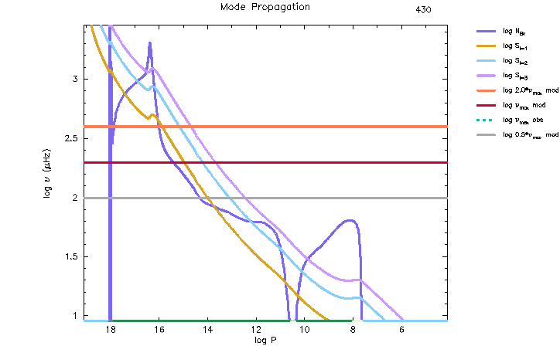
Core Helium Burning 30 M
High damping frequency, log ωdamp (μHz) = 3
1000 s
P-modes, acoustic waves
100 s
g-modes, buoyancy
Low driving frequency, log ωgen = 0.6
10 s

Slide 12
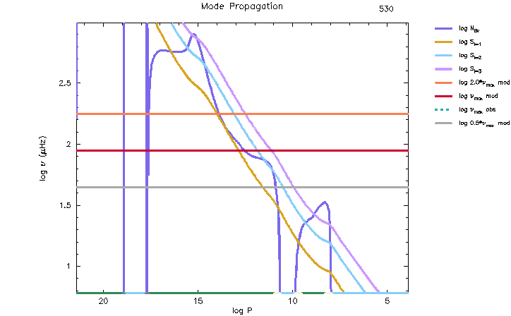
Core Carbon Burning 30 M
damping frequency, log ωdamp = 2.6
100 s
driving frequency, log ωgen = 0.8, 1
10 s

Slide 13
Core Oxygen Burning 30 M
driving frequency,
log ωgen = 2.9, 2.8, 2.1, 2.05, 1.0
1000 s
damping frequency, log ωdamp = 2.4
100 s
10 s

Slide 14
The Magnetorotational Instability in “Betelgeuse”
With Daniel Kagan, Tel Aviv University, Manos Chatzopoulos, Fermi Fellow, University of Chicago.
State of the art is to apply the Spruit/Taylor dynamo in rotating stars, associated viscosity, diffusion coefficient.
Steep gradient in angular velocity at composition boundaries could be unstable to MRI, resulting in viscosity, mixing.
MRI instability criterion
(η/κ)NT² + Nμ² + 2 q Ω² < 0: q = d ln Ω/dln r shear
ν ~ D ~ Br/BΦ r² Ω ~ 0.01 r² Ω from MRI simulations

Slide 15
Effect of Spruit/Tayler, MRI on structure of late stages of 15 M

Slide 16
Rotating 15 M MRI, End of Core Helium Burning

Slide 17
Rotating 15 M MRI, B field at Saturation
Saturation field
Alfven velocity ~ shear velocity
B/(4πρ)^{1/2} r ~ q Ω

Slide 18
Nonrotating 15 M

Slide 19
Rotating 15 M Spruit/Tayler

Slide 20
Rotating 15 M MRI

Slide 21
Rotating 15 M Spruit/Tayler + MRI

Slide 22
Conclusions
There is some promise to do asteroseismology of Betelgeuse, WR stars, other SN progenitors to constrain, mass, composition structure, rotation distribution, magnetic field distribution.
The MRI may be active in the late stages of massive star evolution, affect on mixing, rotational profile, magnetic field strength, distribution.
Very complicated. Oscillation modes interact, rotation and magnetic effects are 3D, implemented in 1D MESA code.
Long way to go, but potentially very interesting.

