Slide 1
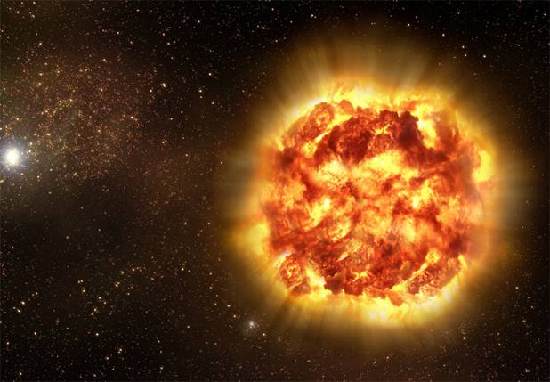
Expanding Knowledge from Exploding Stars
Observations of
Supernovae
NIR Spectroscopy
NIR Photometry
Optical & UV data
Combined Data Sets
Howie Marion
UT Astro

Slide 2
Why Supernovae?
Physics & Cosmology
Haven’t you already done this?
Why do you need one more light curve (or spectrum)?
There is no such thing as a normal supernova
We continue to learn from supernovae
SN are unique probes of many astrophysical events
New telescopes, New detectors, New methods

Slide 3
You’re only as good as your collaborators
Eric Hsiao (CSP), Jozsef Vinko (Szeged/UT),
Jeff Silverman (UT)
Dan Milisavljevic (CfA), Rafaella Margutti (CfA), Ryan Foley (CfA/Illinois), Ryan Chornock (CfA), Carlos Contreras (CSP/Aarhus),
Nidia Morrell (CSP), Perry Berlind (FLWO),
Melissa Graham (LCOGT/Berkeley),Peter Brown (TAMU),
Jerod Parrent (LCOGT/CfA), Ori Fox (Berkeley),
Stefano Valenti (Pessto/LCOGT), Andy Howell (LCOGT),
Max Stritzinger (Aarhus/CSP2), Dave Sand (LCOGT/Texas Tech),
Maryam Modjaz (NYU), Andy Friedman (CfA/MIT),
Kaisey Mandel (CfA), Ashley Zauderer (CfA), Xiaofeng Wang (Tsinghua)
Craig Wheeler, Bob Kirshner, Nick Suntzeff, Mark Phillips, Kevin Krisciunas, Peter Höflich, Peter Garnavich, Peter Challis, Alicia Soderberg, Edo Berger, Rob Fesen

Slide 4
Combined Data Sets
Plenty of Data to Satisfy Everyone
Optical
  Spectroscopy – HET, SALT, FAST, FLOYDS, LCO
  Photometry – CSP II, FLWO, LCOGT, Konkoly
NIR
  Spectroscopy – Magellan/FIRE, IRTF/SpeX
    10 full nights NIR spectroscopy - Oct 24 and Dec 23
  Photometry – RATIR, LCO, PAIRITEL
UV
  Spectroscopy – Swift, HST
  Photometry – Swift, HST

Slide 5
UVOIR observations of SN IIb 2011dh
Marion et al. 2013

Slide 6
Marion et al. 2013
NIR spectra identify the emergence of Helium
OIR fits temperature profiles
SN IIb 2011dh: NIR + optical

Slide 7
H and He layers separated by 4000 km/s
Consistent with H-rich shell around SN
Marion et al. 2013

Slide 8
Bolometric LC
of SN IIb
In SN 2011dh,
NIR contributes about
30% of the total energy
LCs similar after 25 days
First He I detected at different times
Similar progenitors with different H-shell masses
Marion et al. 2013

Slide 9
High Velocity Absorption Features in SN Ia 2009ig
Marion et al. 2013

Slide 10
Si, Ca & Fe are all produced in different line-forming regions
Separation
Marion et al. 2013

Slide 11
Si II 6355Å in six SN Ia with observations < -10d
All line profiles fit sequence defined by SN 2009ig

Slide 12
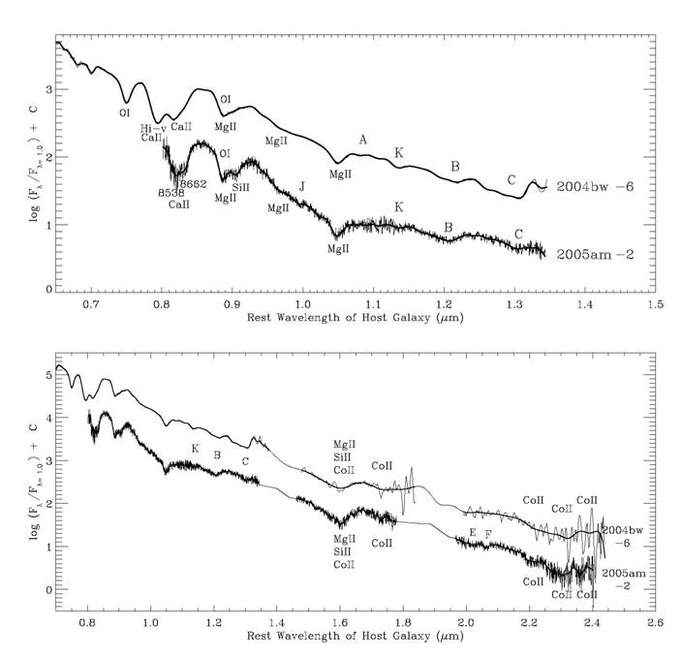
NIR Absorption features
of SN Ia
MgII from 1.0927 µm
MgII
1.0927 µm
Relatively unblended
Covered by
all spectra
in our sample
Top: λ = 0.65 – 1.35 µm
Bottom: λ = 0.7 – 2.5 µm

Slide 13
Mg II 1.0927 μm
features in
53 NIR spectra
of 31 SNe Ia
Note C I features
Marion et al. (2013 in prep.)

Slide 14
Mg II 1.0927 μm: Correlations found between Line Depth, FWHM and Δm15
Red dots are -15d to -4d.
Blue are -3d to +3d.
Green circles +4d to +6d.
Marion et al. (2013)
Marion et al. (2013 in prep.)

Slide 15
NIR K-corrections
The K-correction “corrects” for the fact that
sources are observed at different redshifts.
Gooding (unpublished) Boldt et al. 2103 (in prep.)

Slide 16
NIR K-corrections
Luis Boldt et al. 2103
(in prep.)
Based largely on
Marion Catalog (2009)

Slide 17
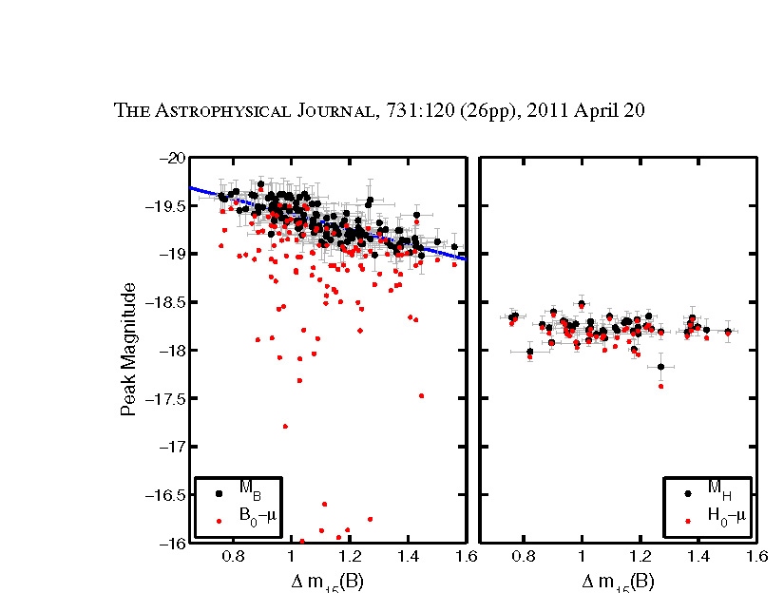
RAISIN
PanSTARRS discovery => MMT confirmation =>
HST observations in NIR => improved precision (and accuracy!)
At H-band (1.6m) SN Ia really are standard candles
(and there’s much less trouble with dust!)
Mandel, Narayan & Kirshner (2011)
Notes:
This is Nature’s way of telling you how to proceed!
SN Ia are better standard candles in the IR without any of the legerdemain of light curve shapes than they are in the optical after all the corrections.

Slide 18
SN 2010kg & 2011by

Slide 19
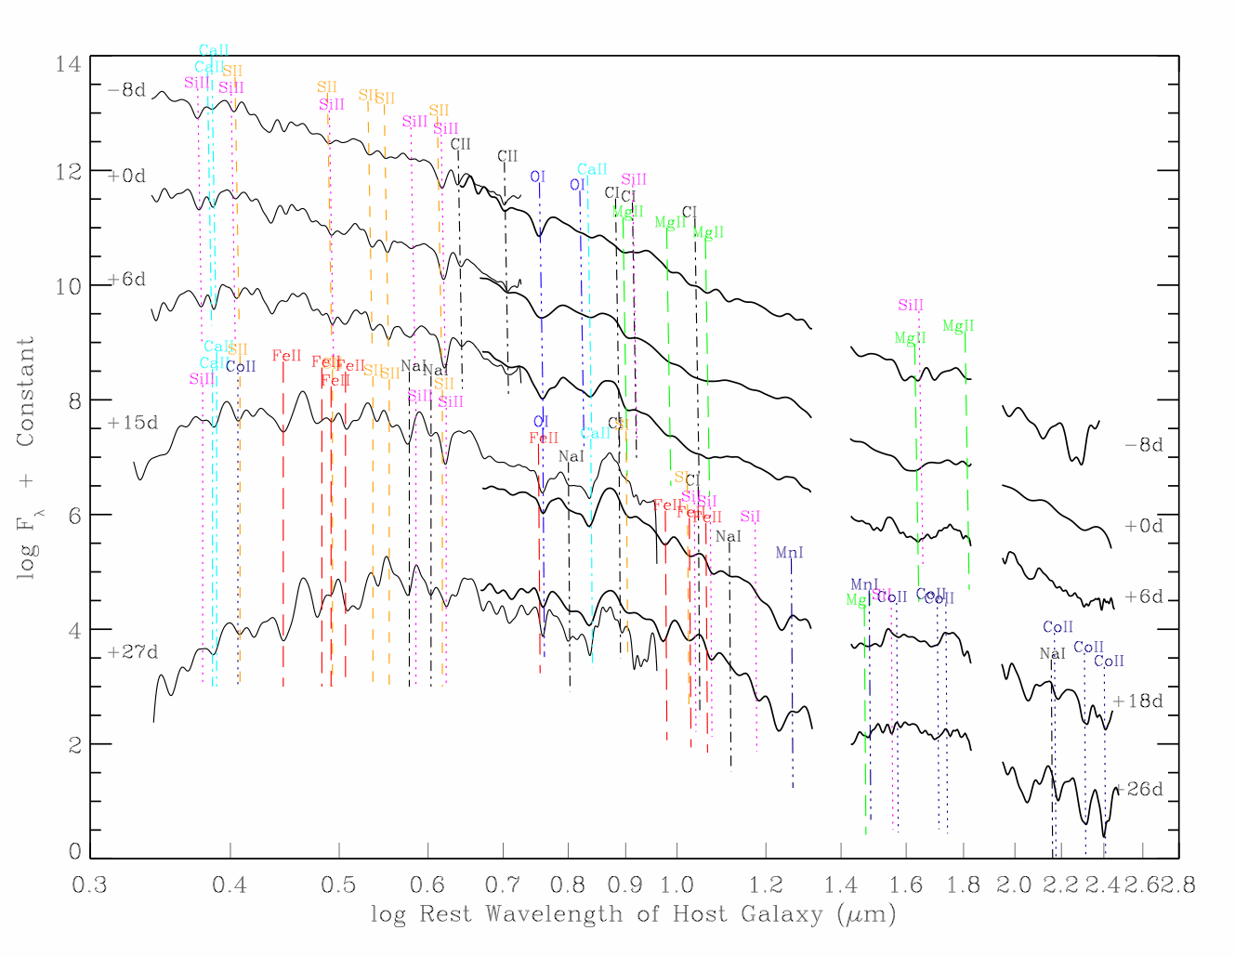
SN 2009dc: C I is absent at all epochs C II present from -8d to +9d

Slide 20
Ten years of “Snapshot” NIR spectra reveal patterns of spectral evolution associated with the chemical structure
Limited overlap with NIR photometry and optical spectra
Some of the features we have discussed during this meeting

Slide 21

A new Era of NIR spectroscopy

Slide 22
NIR Spectral Series of SN 2011fe
Hsiao, Marion et al.
(2012)
Sn11fe goes here

Slide 23
Three major results from Hsiao & Marion
to be tested with Marion catalog
C I may be ubiquitous
Mg II velocities are constant
H-band break definition

Slide 24
High-velocity Ca II
Well known in SN Ia
but poorly analyzed
Through 2006 – 12 HET, 18 IRTF
Silverman et al. 2013 (in prep)
with new HET and BSNIP
384 spectra of 192 SNe
Marion et al. 2013

Slide 25
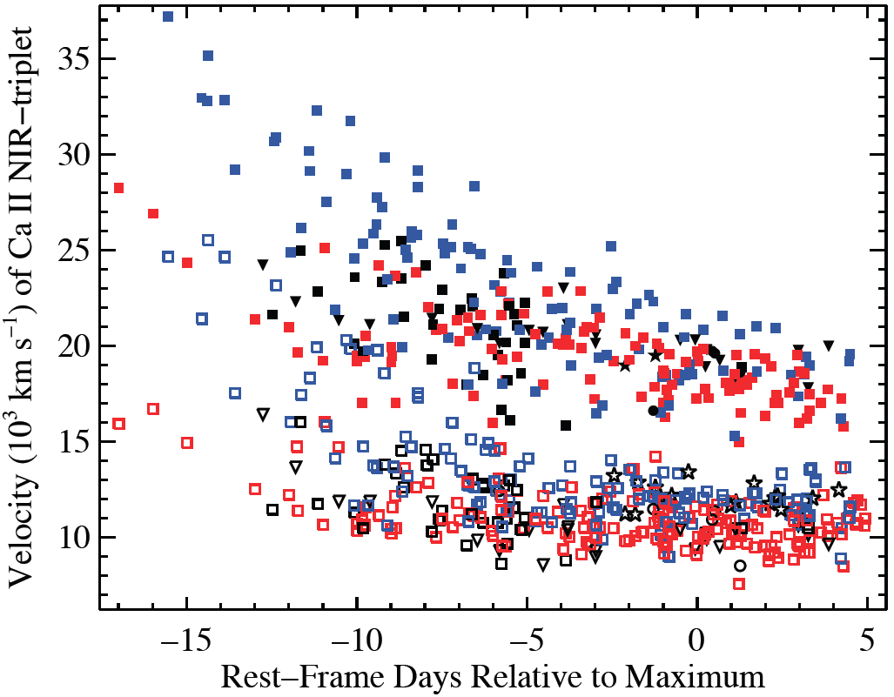
HVFs and PVFs well separated at all times
Less velocity spread in PVFs
EWs of HVFs are larger at t < -5d
PVFs are stronger after that
Filled – HVFs
Open – PVFs
Silverman et al. 2013 (in prep)
Notes:
Full dataset for CaIR3 (384 spectra of 192 SNe), v CaIR3 vs. t, similar stuff for CaHK.
Open points are PVFs and filled points are HVFs.
I’ll go through the colors and shapes in the next slides, but you can see both HVFs and PVFs decrease with time.
They are relatively well separate at all times, very well separated at t < -5 d or so. Also, less velocity spread in PVFs.
HVFs are 37000 km/s decr. to 17000 km/s or so. PVFs are 25000 km/s for a couple objects very early-on, most are 14000-15000 km/s (near t = -10 d), decr. 11000 km/s.
Difference decr. w/ t at 4-sigma level from ~11 to ~7.5 in epoch range.
In general, the EWs of HVFs are larger than PVFs for t < -5 to -4 d, PVFs are stronger after that

Slide 26
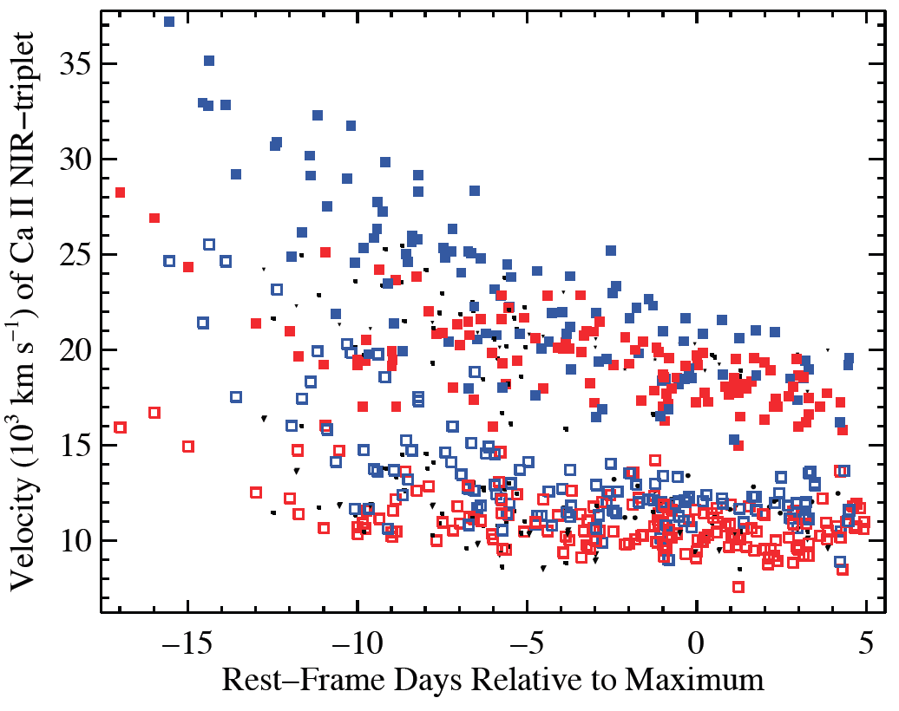
~75% of SN Ia (BSNIP+HET catalog) show HVFs
26% are (Wang) HV
Different slopes for HVF ?
Blue – HV (>12,500 km/s)
Red – normal
Silverman et al. 2013 (in prep)
Notes:
Red is Normal vel SN Ia, blue is HV objects.
(26% are HV, consistent w/ BSNIP II and Wang.)
~75% of the both HV and N show HVFs.
HV (both HV and PS) start w/ higher vels than N and drop faster, HV end w/ a bit higher vels (both HV and PS) than N

Slide 27
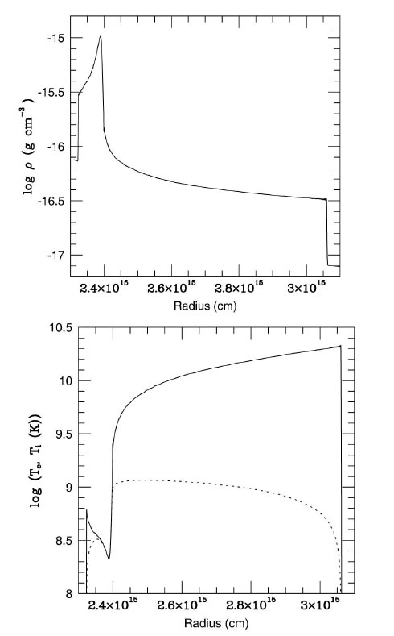
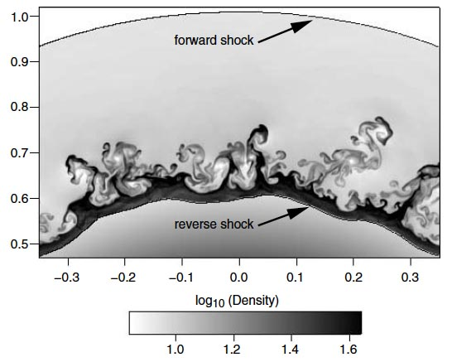
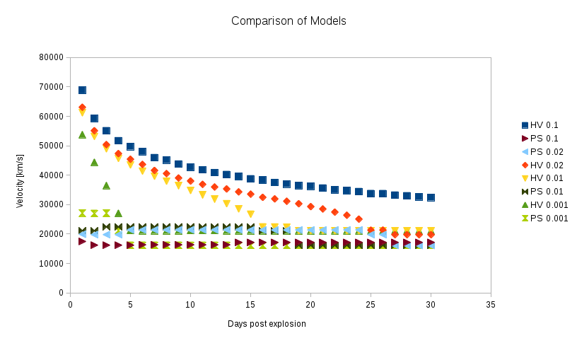
Contact Discontinuity
H, He, primordial Ca
Si, IME
H, He, primordial Ca
Si, IME
Explaining HV features
Wheeler et al. (ongoing)
– forward, reverse shocks,
RT contact discontinuity

Slide 28
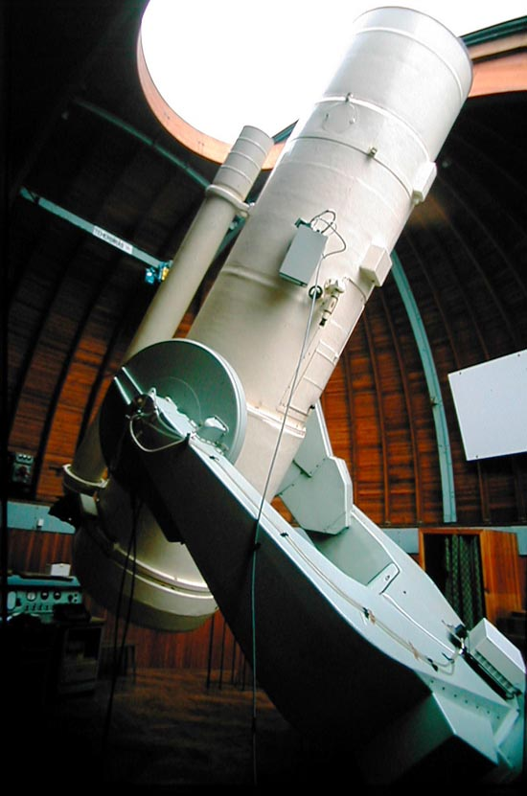
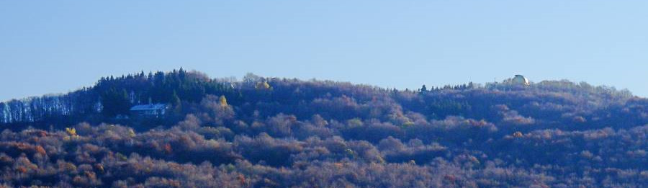



BVRI photometry
Konkoly Observatory
Piszkesteto Station, Hungary
60/90 cm Schmidt telescope
Apogee Alta U16 CCD
Bessell filters
37 nights between Aug.25 - Nov.06.
calibrated via Landolt fields
Jozsef Vinko
(University of Szeged / UT Austin)

Slide 29
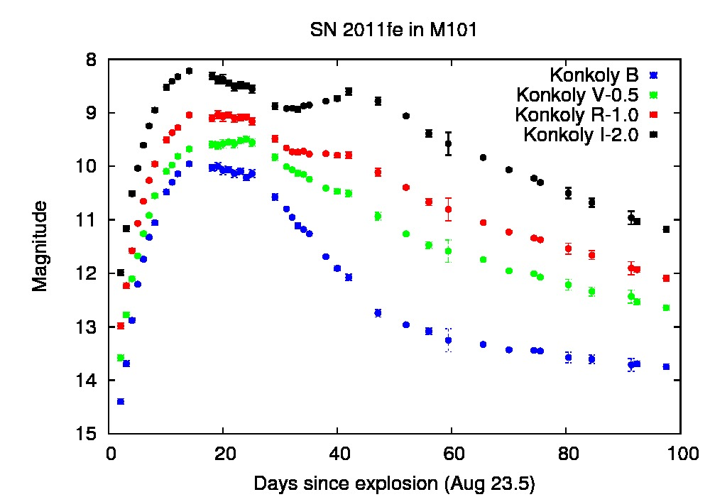
BVRI photometry
Konkoly Observatory
Piszkesteto Station, Hungary
60/90 cm Schmidt telescope
Apogee Alta U16 CCD
Bessell filters
37 nights between Aug.25 - Nov.06.
calibrated via Landolt fields

Slide 30
Distance to M101 from SN 2011fe
Method | μ | δμ | Reference
MLCS2k2 | 29.21 | 0.07 | this work
SALT2 | 29.05 | 0.08 | this work
Tully-Fisher | 29.20 | 0.50 | Pierce, ApJ 430, 53 (1994)
EPM | 29.35 | 0.40 | Schmidt et al. ApJ 432, 42 (1994)
Cepheids | 29.13 | 0.11 | Freedman et al. ApJ 553, 47 (2001)
Cepheids | 29.06 | 0.11 | Newman et al. ApJ 553, 562 (2001)
Cepheids | 29.04 | 0.05 | Shappee & Stanek, ApJ 733, 124 (2011)
TRGB | 29.05 | 0.06 | Shappee & Stanek, ApJ 733, 124 (2011)

Slide 31
Classification of ROTSE SNe with HET
SN 2012X (Ia, z=0.1)
SN 2012ab (IIn, z=0.02)
SN 2013dz (IIn, z=0.05)
SN 2010kd (Ic SLSN, z=0.1)

Slide 32
SN 2009ip
SALT
SALT
MMT
MMT
SALT
SALT
FAST
FAST
MMT hr
FAST
FAST
FAST
FAST
Margutti et al. 2013

Slide 33
Hα in SN2010jl
2 years of FAST data
R~3000
HET/HRS
FLWO 1.5m/TRES
R~30,000
Margutti et al. 2013

Slide 34
SN 2010jl FLWO photometry

Slide 35
Jerod Parrent (LCOGT/CfA)

Slide 37
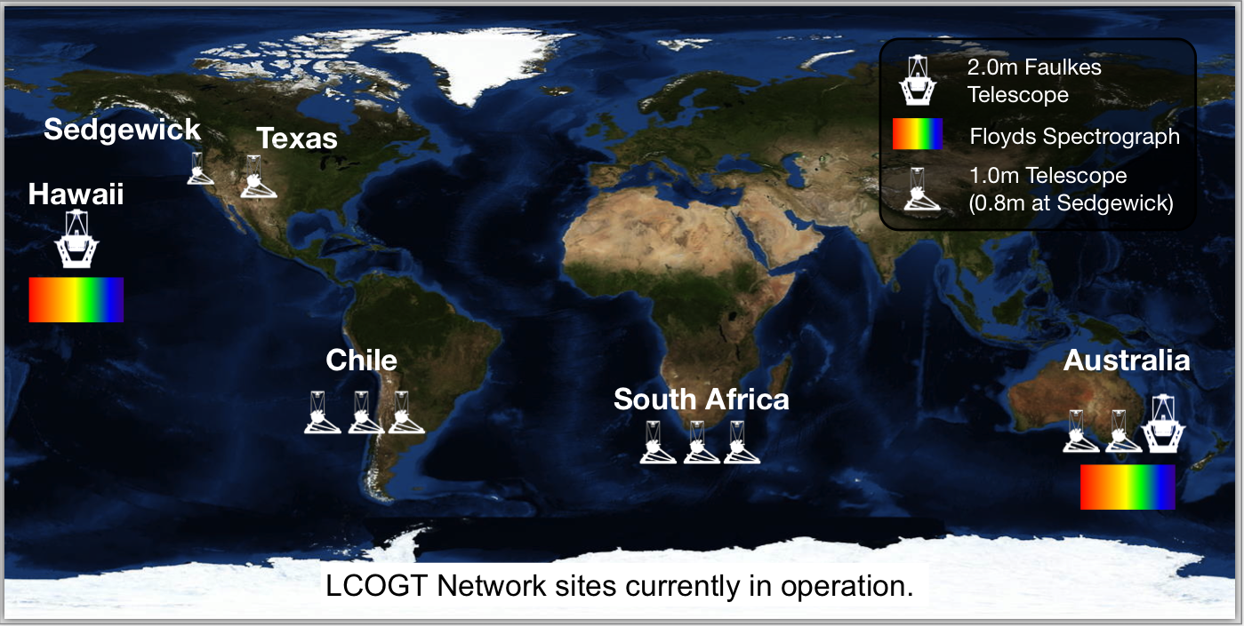
Las Cumbres Observatory Global Telescope Network
Nine 1.0m telescopes in full robotic operations
  every clear night and scheduled in real time
The Floyds Robotic Spectrographs: operating in full robotic mode.
2.0m Faulkes Telescopes: SN imaging and host to FLOYDS

Slide 38
LCOGT
griz light curves
Melissa Graham
Stefano Valenti
Andy Howell

Slide 39
Friedman et al. 2013?

Slide 40
NIR Light Curves
from PAIRITEL
Andy Friedman
CfA/MIT

Slide 41
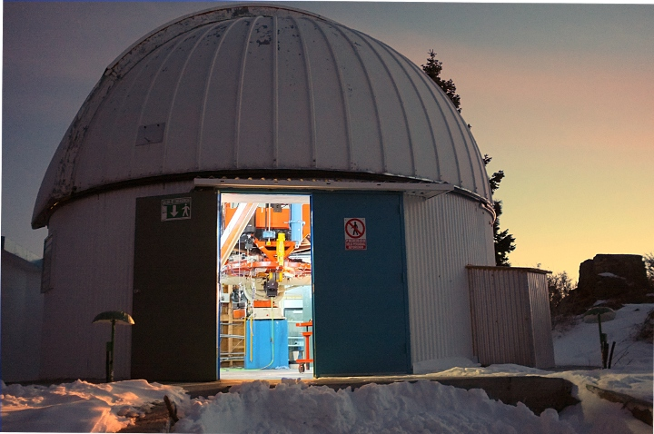
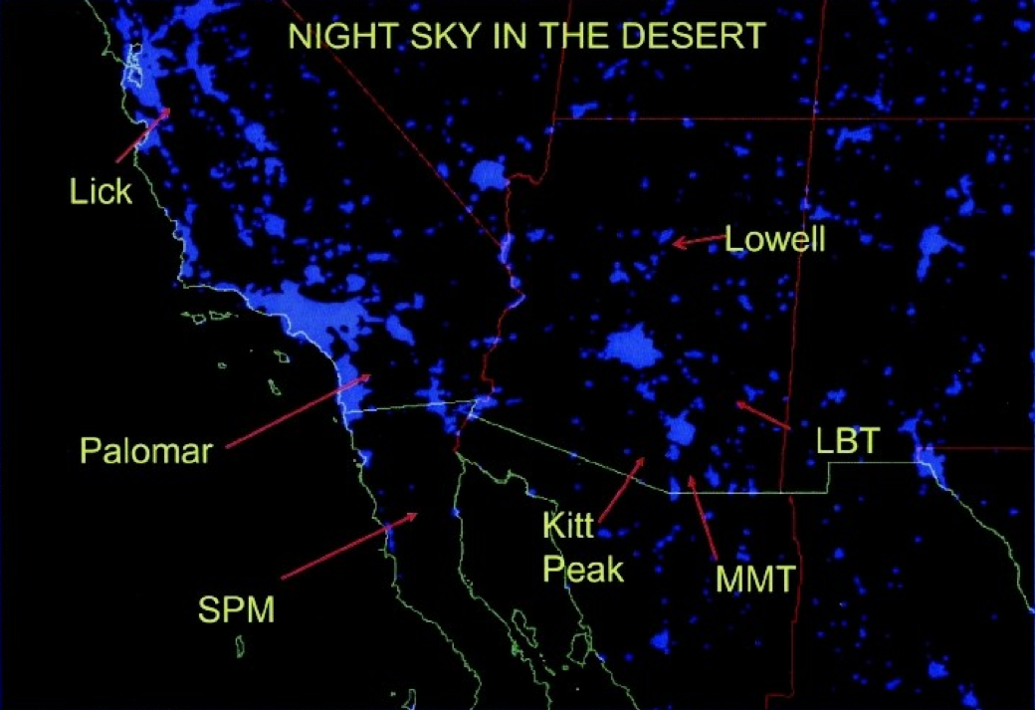
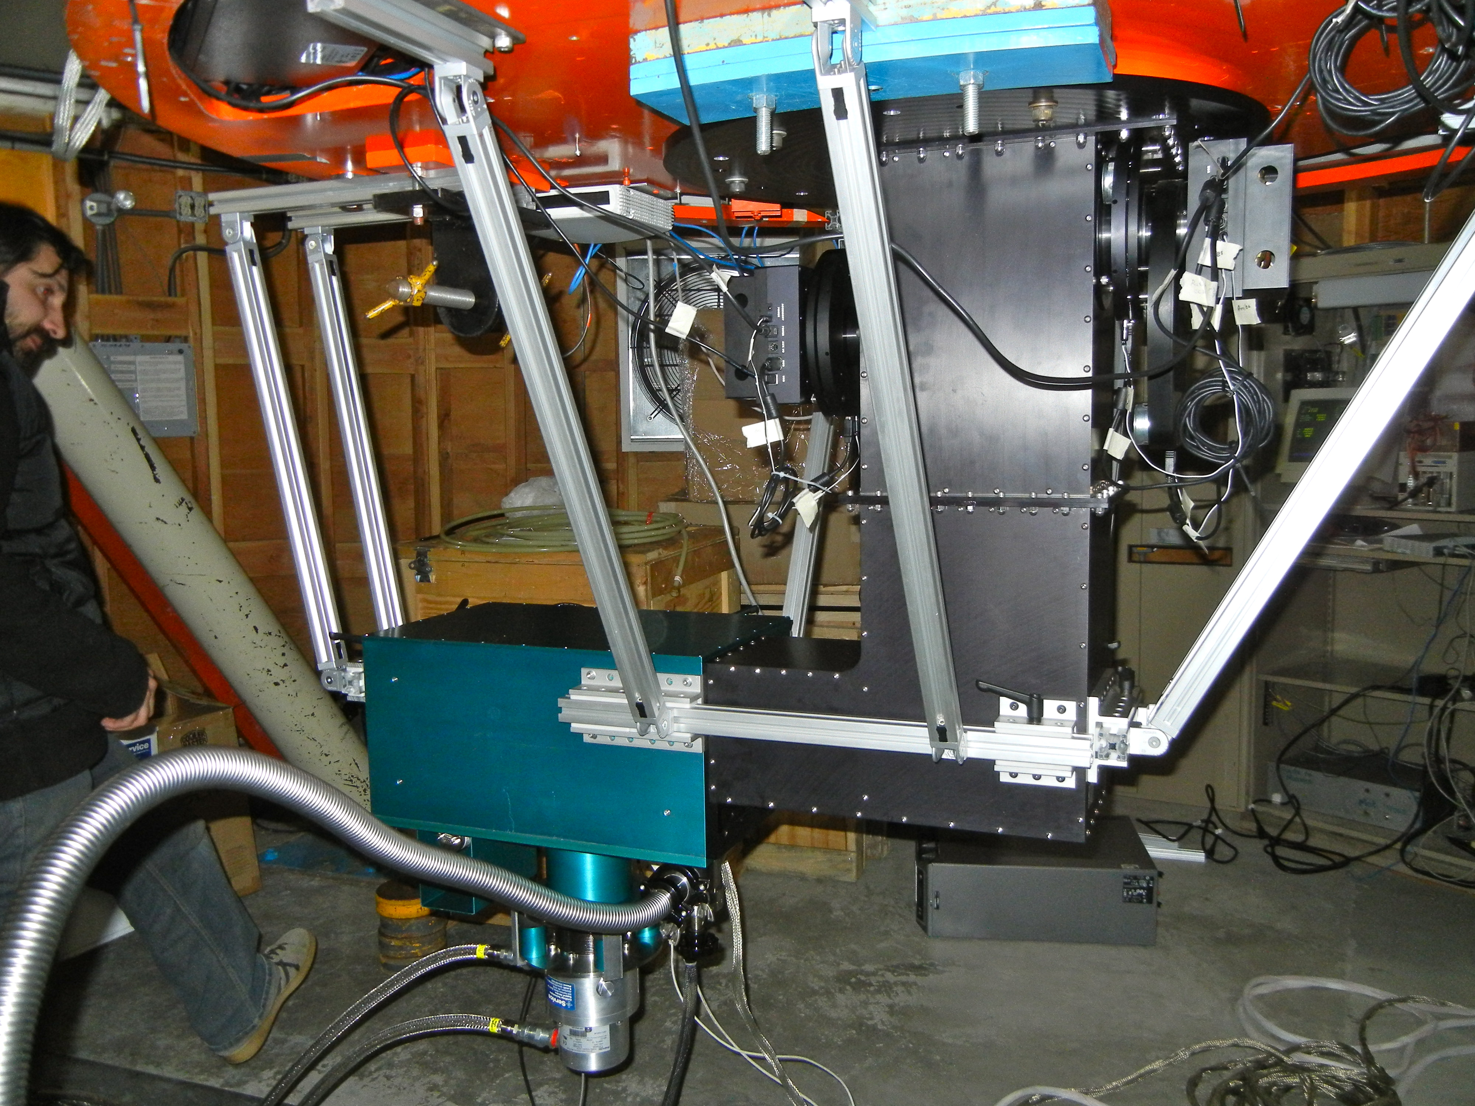
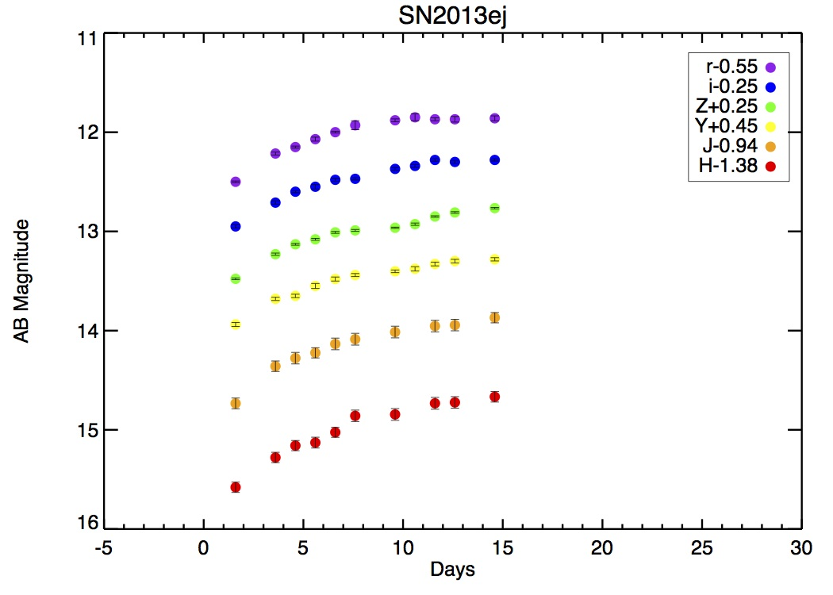
RATIR Light Curves
The Reionization and Transients Infrared Camera/Telescope
“RATIR First Light,” Butler+12
“IR Detector Subsystem,” ODF+12
Ori Fox
Berkeley
Great weather and seeing (~0.8-1 arcsec)
Full roboticization and quick-response capabilities
100% dedication to instrument
Simultaneous Vis/IR photometry
Notes:
JWST
TMT
First stars and galaxies,
Etc etc

Slide 42
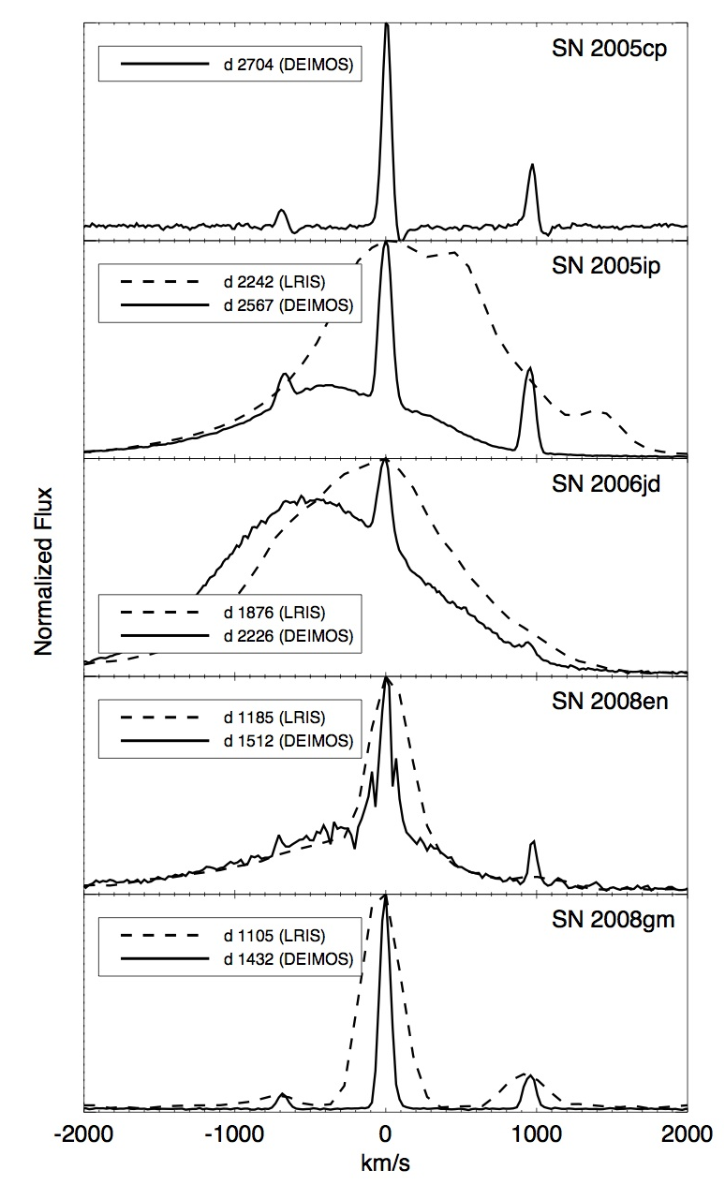
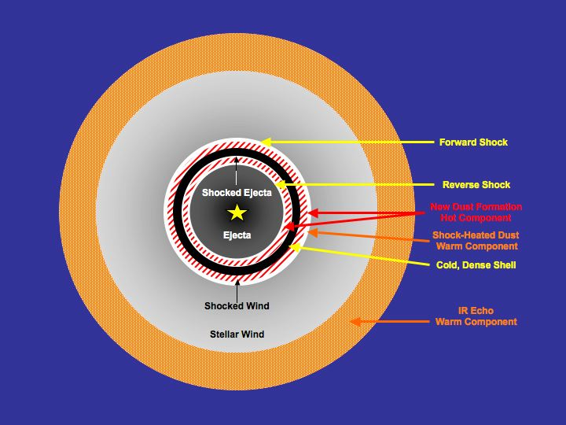
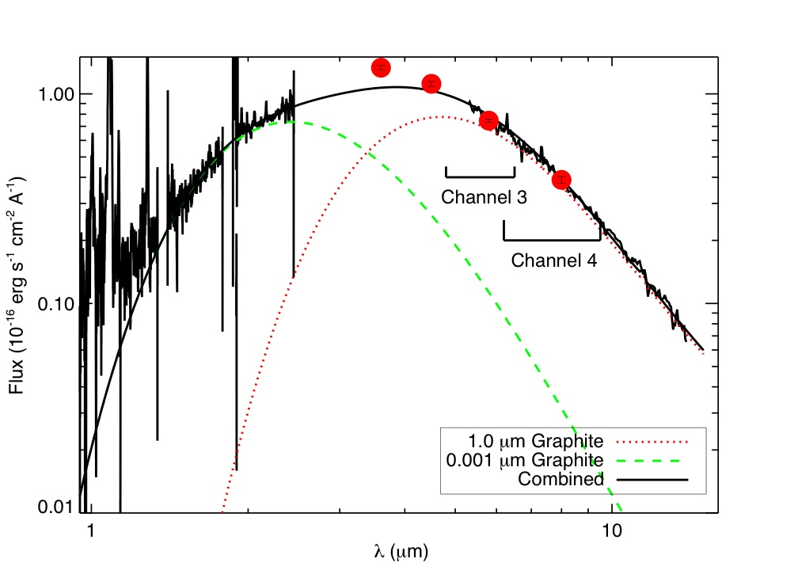
Late-Time Optical and IR
Emission in SNe IIn
Dust
ODF+10
SN 2005ip
Notes:
This is a plot that shows late-time emission detected from a Spitzer selected sample of SNe IIn. There are a lot of things going on this slide.
First, our results show that a significant fraction (>30%) of SNe IIn show evidence for late-time emission from warm dust (Fox+11).
Interestingly, this sample of SNe IIn also tend to have an associated optical emission (and in some cases, X-ray) from ongoing shock interaction with the CSM.
A great example is the case of SN 2005ip, which has very well-sampled optical and near-IR light curves.
The combined SED and light curves allow us to constrain the origin and heating mechanism of the warm dust. For most Sne Iin, the dust appears to be *pre-existing* at the time of the SN explosion and continuously heated by radiative emission generated by ongoing shock interaction with the dense CSM (Fox+13a). Armed with this knowledge, you can determine the geometry and composition of the CSM, which in turn can be used to derive the pre-SN mass-loss rates as a function of time. These numbers provide important constraints on the progenitor system. In the case of Sne Iin, the mass-loss characteristics are consistent with LBVs, but raise a number of new questions about the late-stages of massive star evolution (see Shiode+13).

Slide 43
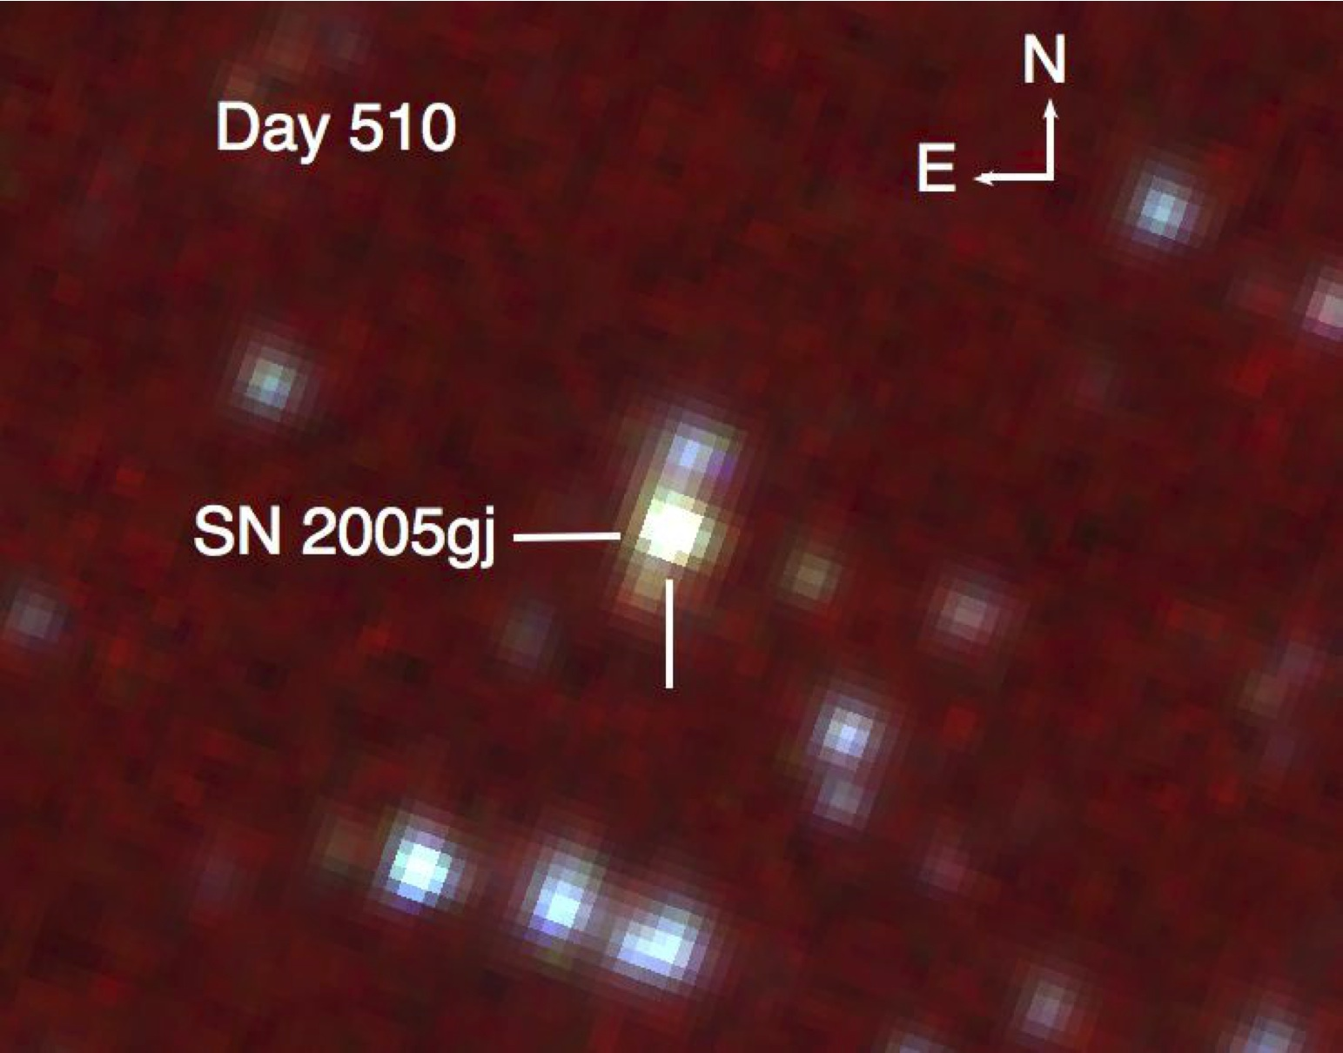
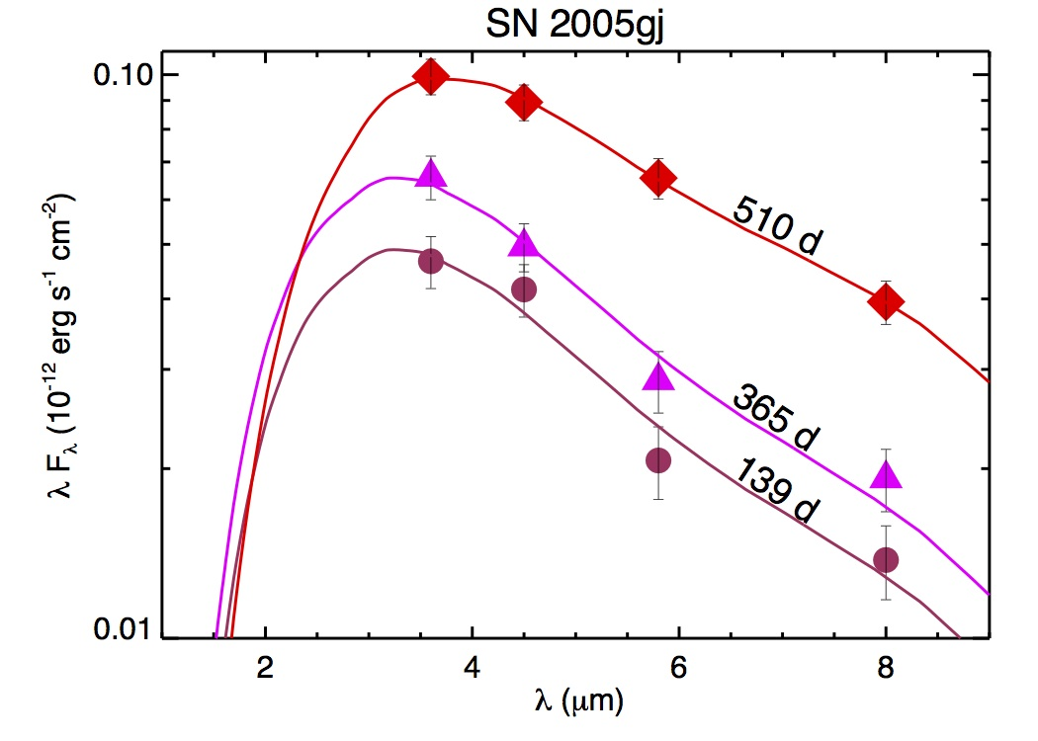
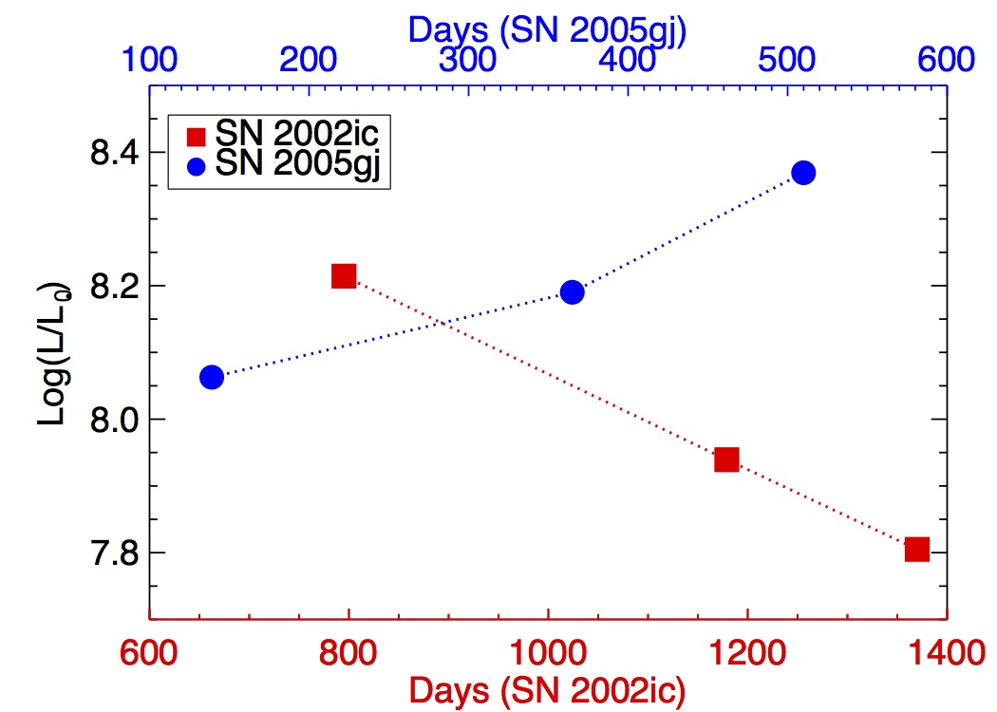
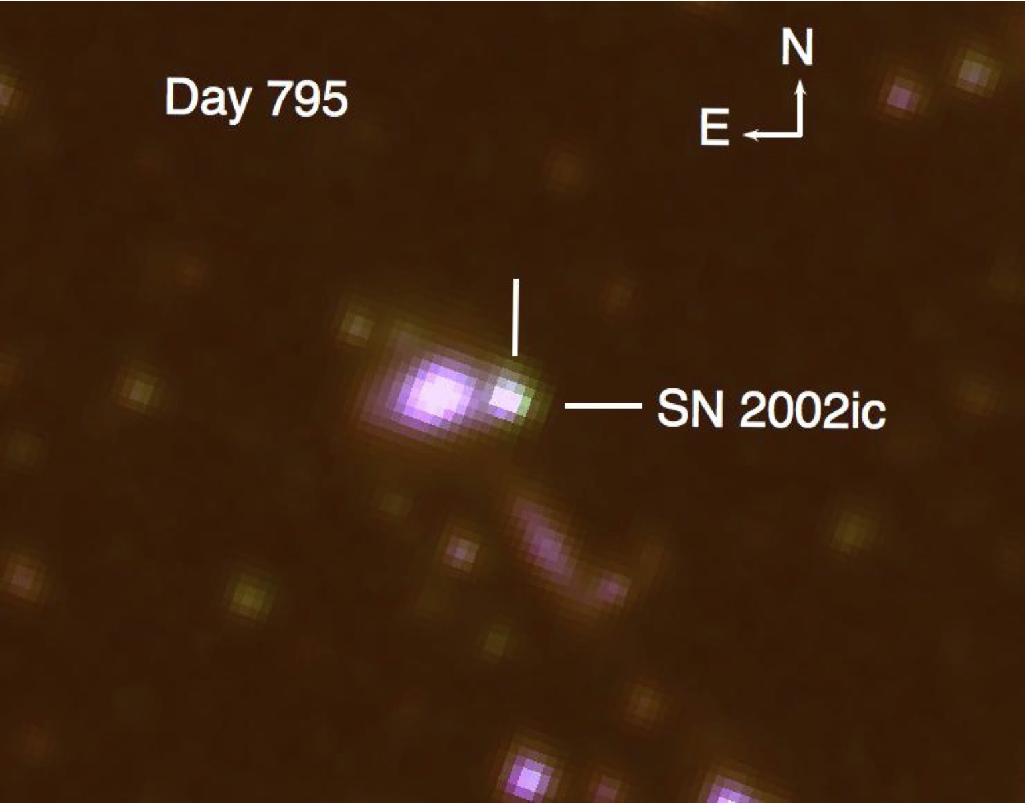
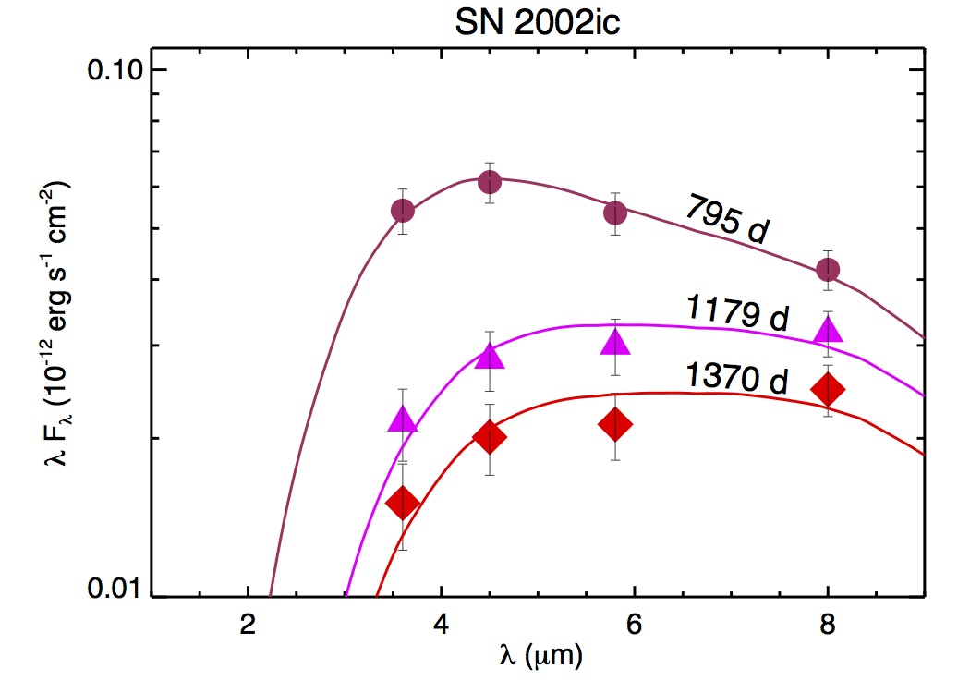
SNe Ia-CSM 2002ic and 2005gj
Spitzer False Color
Notes:
SNe Ia-CSM are a unique subset of SNe Ia that show evidence for CSM interaction (see Silverman et al. 2013). Two of the SNe Ia-CSM in Silverman’s sample are detected in the mid-IR at multiple epochs in archival Spitzer observations. SN 2002ic represents the latest detection of a SN Ia to-date (~1400 days). And SN 2005gj shows unprecedented rebrightening more than a year post-discovery. We attribute this late-time mid-IR emission to pre-existing dust shells that were most likely formed by progenitor outbursts. Optical and X-ray emission from continuous shock interaction radiatively heats the dust shells, just like the SNe IIn!

Slide 44
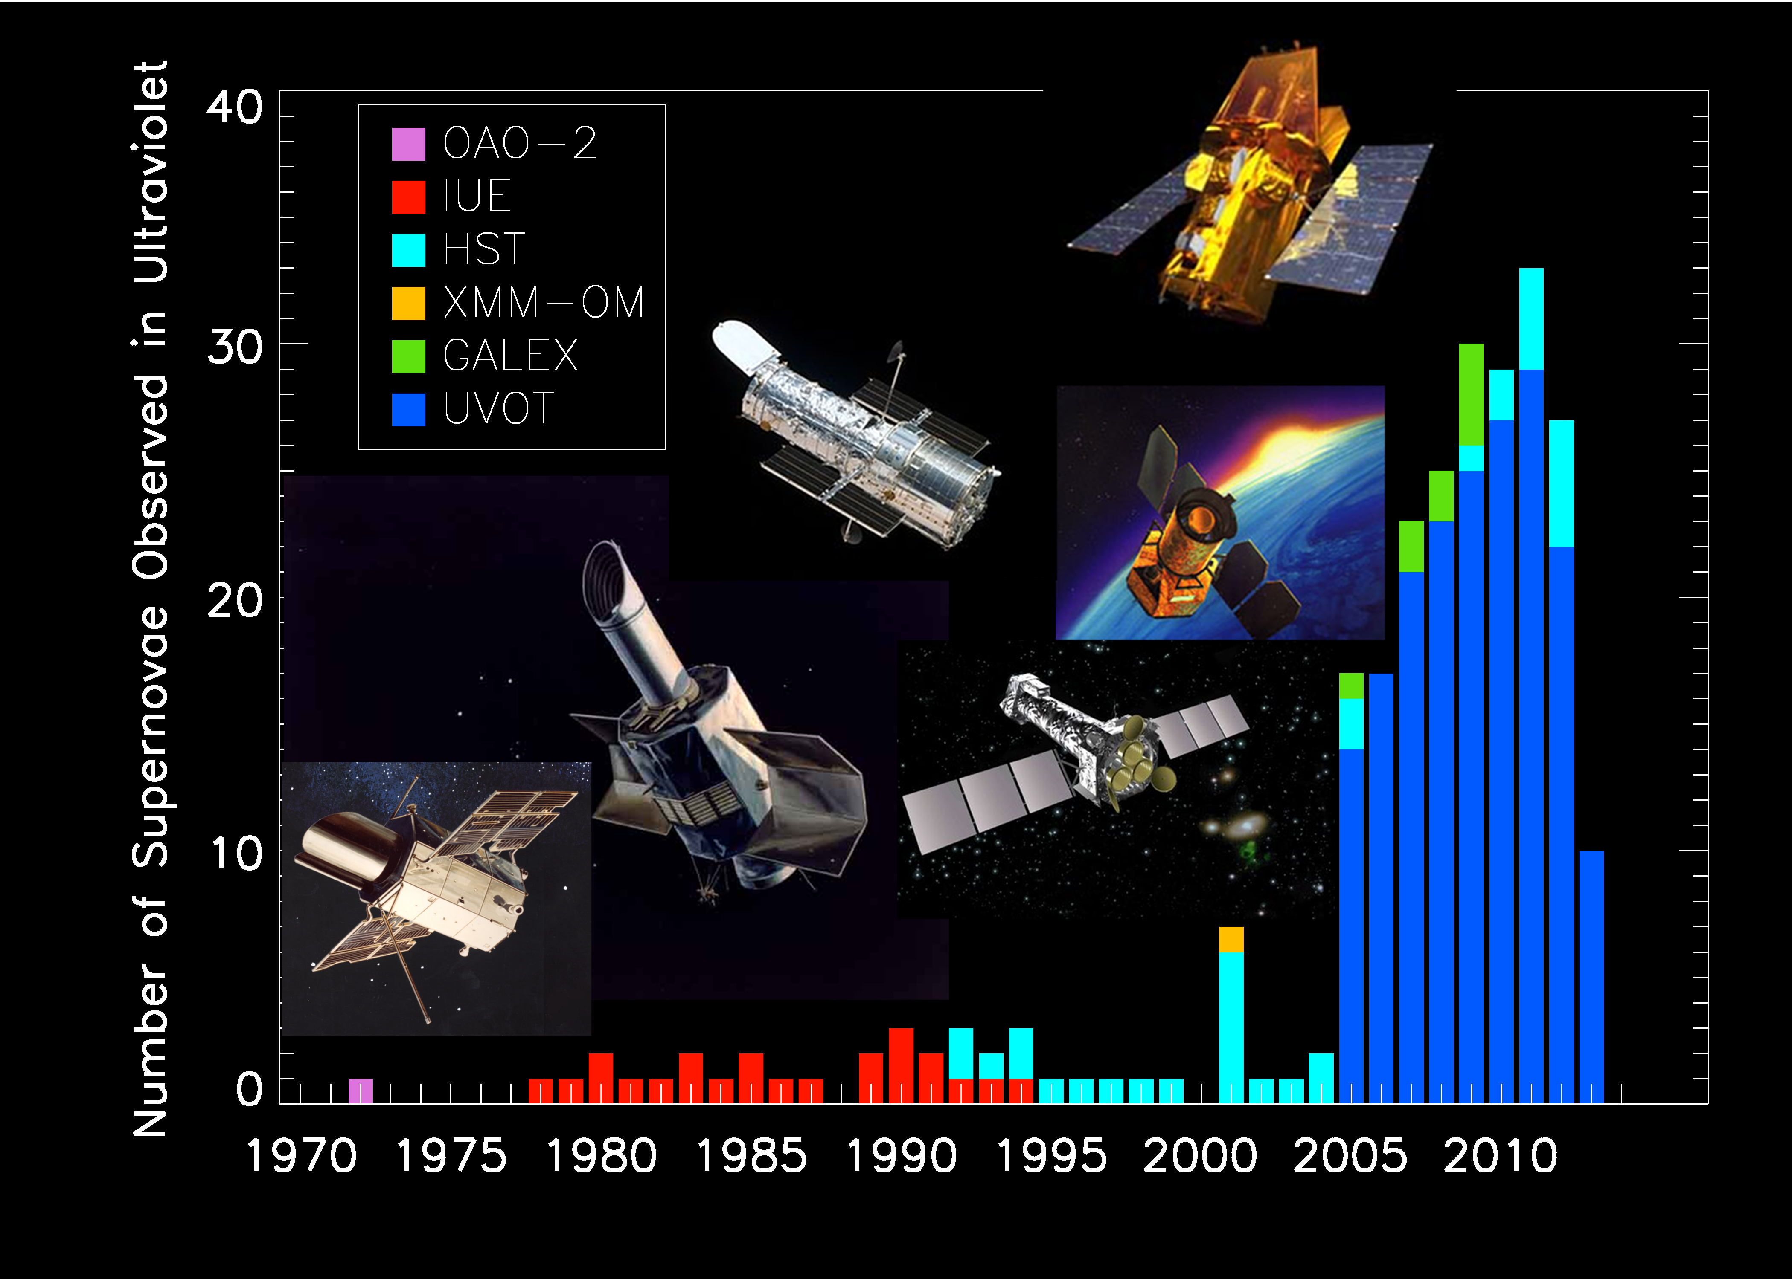
A Swift Explosion in the number of SNe observed in the UV

Slide 45
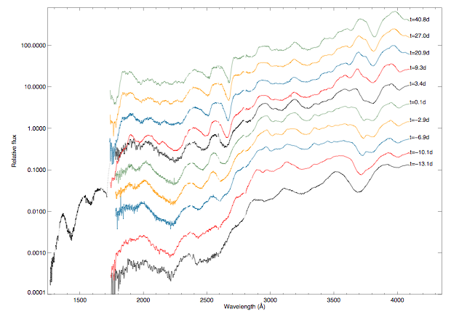
High Quality HST UV Spectral Series UVOT grism
Mazzali et al. 2013 arXiv:1305.2356

Slide 46
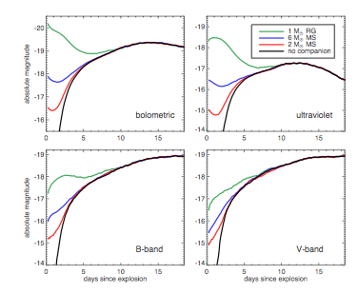
UV Observations are more sensitive to the shock from SN Ia interacting with companion
Shock emission is brighter in the UV
SN emission is fainter in the UV
Larger companions > larger separation > brighter luminosity
Kasen 2010
Kasen 2010

Slide 47
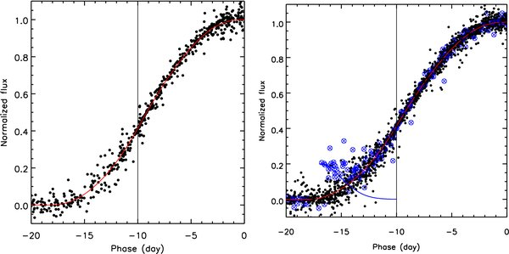
No Evidence for a Binary Companion in SN Ia
Data
Simulations
Hayden et al. (2010) searched for shocks in 108 SDSS SNe without seeing the optical bump expected for 10% of SNe
See also Tucker et al. (2011), Bianco et al., Ganeshalingham et al., probably a few others

Slide 48
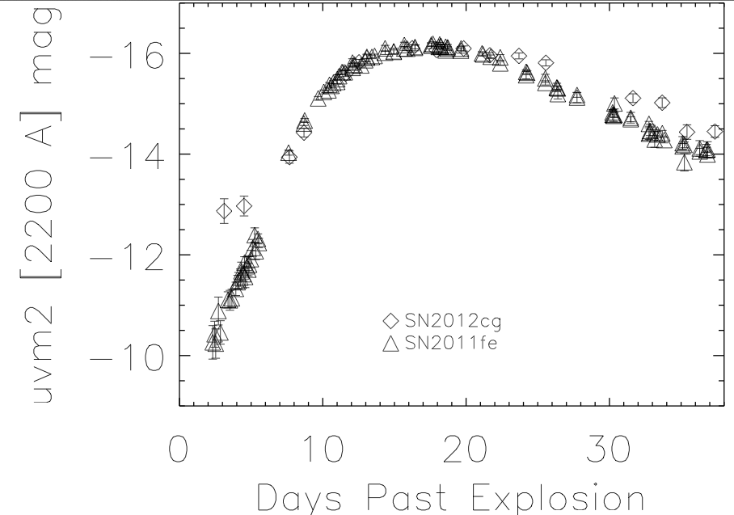
SN2012cg – early shock bump?

Slide 49
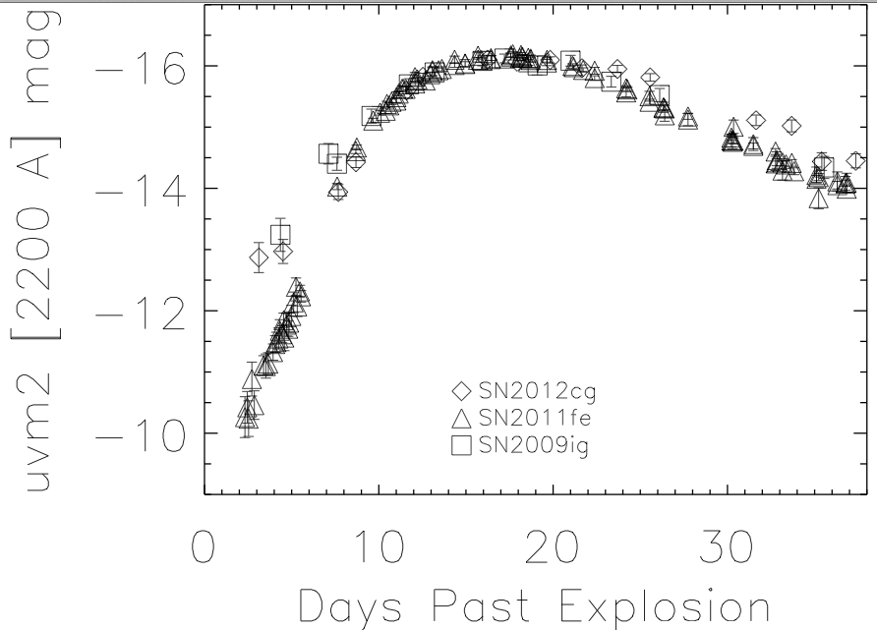
Is the bump unique? Is it a shock?

Slide 50
SN 2012cg
Extensive optical LCs & spectra
Possible Interaction with Companion?
Are KAIT or FLWO data correct?
Swift supports FLWO
LCOGT??

Slide 51
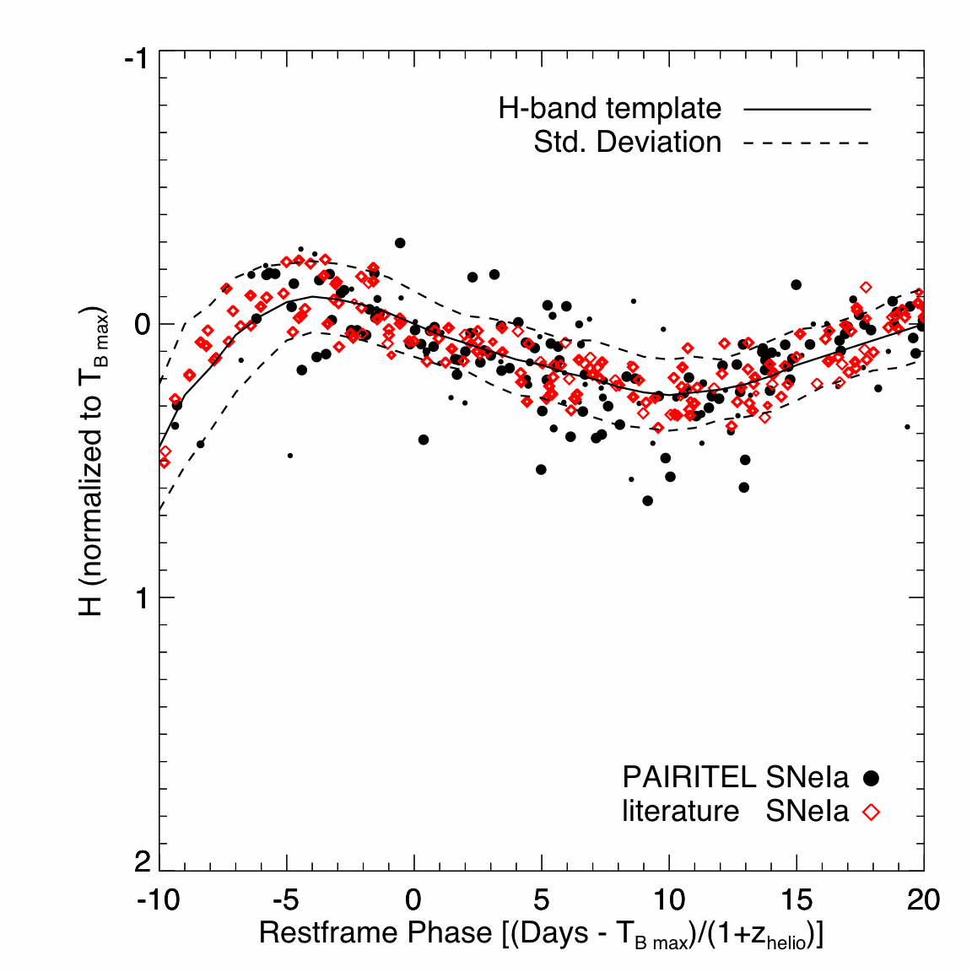
SN Ia are better standard candles in the NIR than they are in the optical
Kasen 2006
Wood-Vasey 2008
Observed H-band scatter is consistent with theoretical predictions, and is comparable to the scatter in optical data after correction for light curve shape.

Slide 52
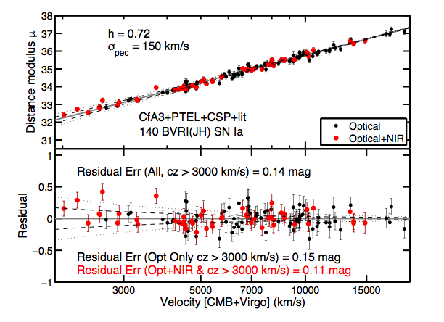
BayeSN – simultaneous fits to optical and NIR LC
Reduces scatter in the Hubble Diagram

Slide 53
RAISIN
PanSTARRS discovery => MMT confirmation =>
HST observations in NIR => improved precision (and accuracy!)
At H-band (1.6m) SN Ia really are standard candles
(and there’s much less trouble with dust!)
Mandel, Narayan & Kirshner (2011)
Notes:
This is Nature’s way of telling you how to proceed!
SN Ia are better standard candles in the IR without any of the legerdemain of light curve shapes than they are in the optical after all the corrections.

Slide 54
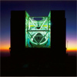
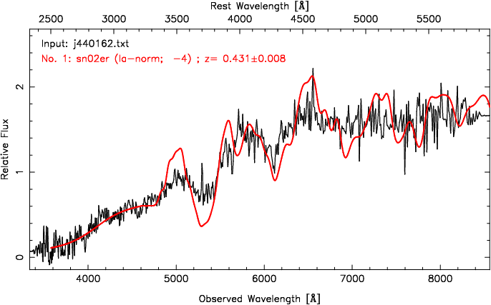
Discovery with PanSTARRS
Get spectrum with MMT

Slide 55
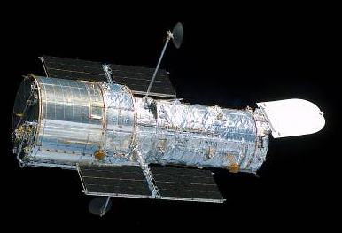
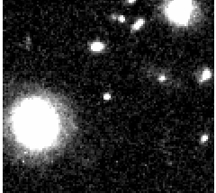
IR photometry with WFC3
Goal: better knowledge of dark energy by avoiding systematic errors
Notes:
Restframe IR

Slide 59
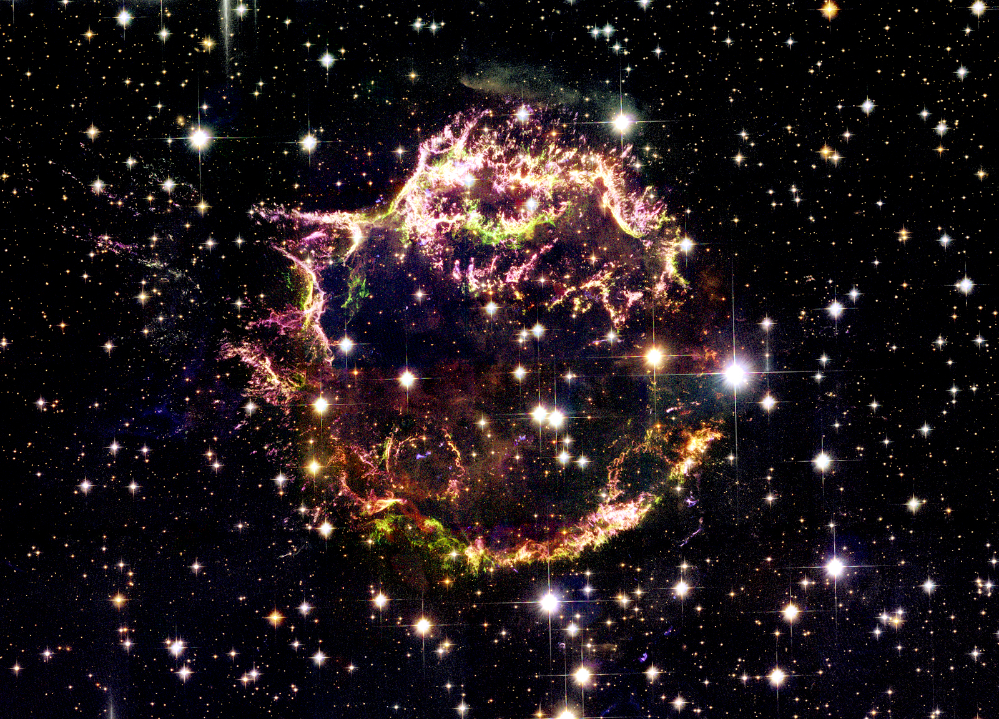
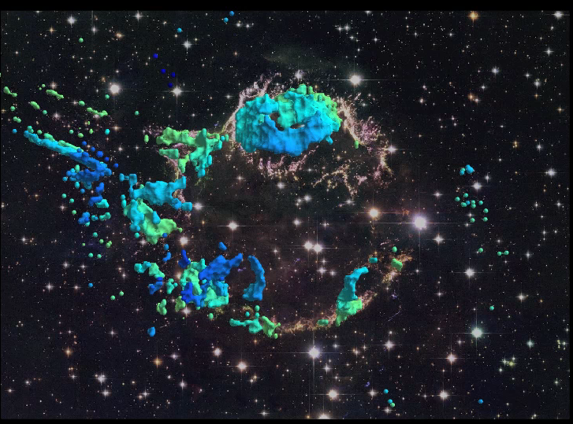
Cas A in 3D:
A Blueprint for Type IIb supernova Explosions
Core-Collapse Explosion Mechanisms
Neutrinos, fluid instabilities, rotation, and magnetic fields
Dan Milisavljevic
Harvard-Smithsonian Center for Astrophysics

Slide 60
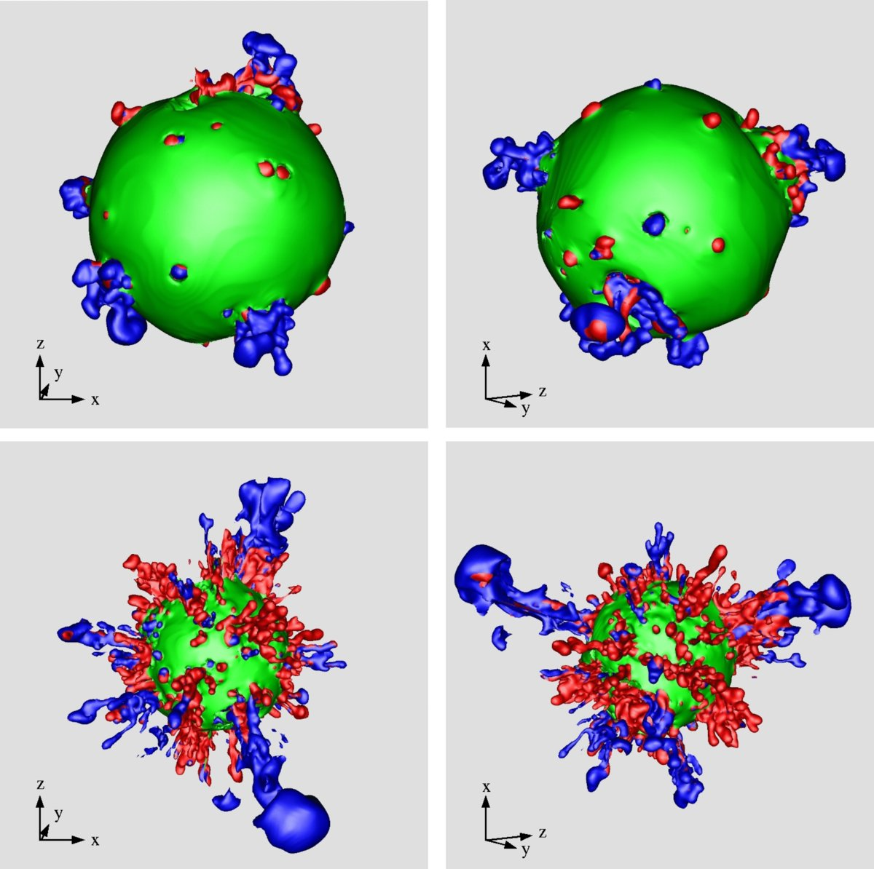
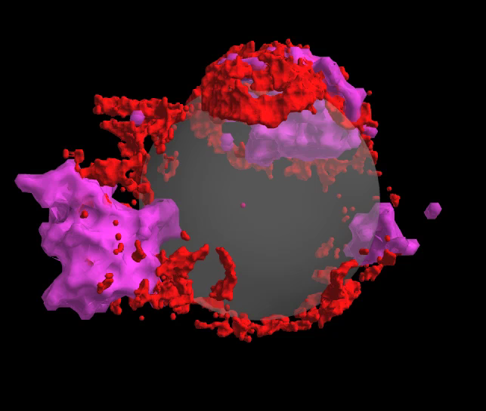
Clues to the Explosion Mechanism
⁵⁶Ni Outflows Bubbles Rings
Carbon
Nickel
Oxygen
Sulfur+Oxygen
Iron
Cassiopeia A
Hammer, Janka, Muller (2010)

Slide 61
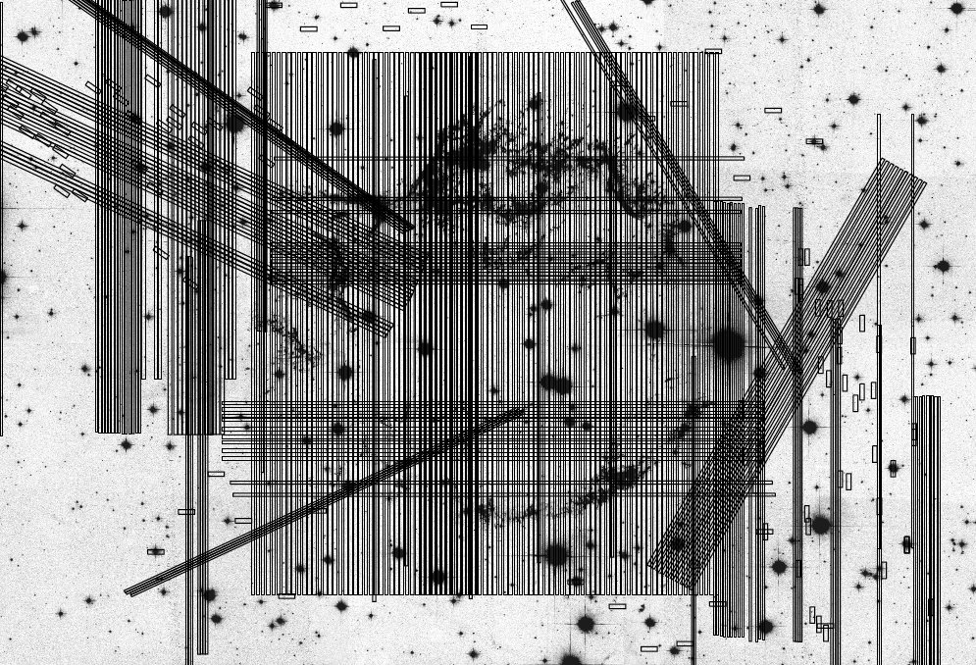

Slide 62
SN 2012au – A “Golden” Link Super-luminous SN and Lower Luminosity Counterparts
Milisavljevic et al. (2013)
Au → Gold!

Slide 63
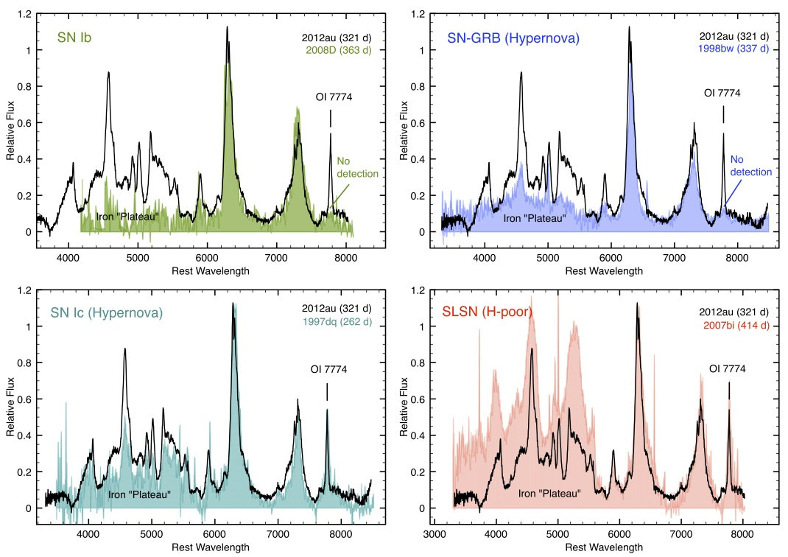

Slide 64
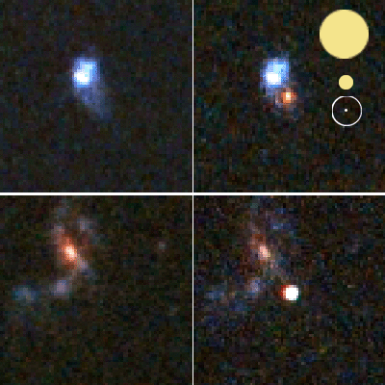
The GMT will really help
Better resolution helps distinguish a supernova from its host galaxy
_{0.5′′ seeing}
_{HST 1.5μm}
_{GMT AO}

