Slide 1
The European Southern Observatory’s
Extremely Large Telescope (E-ELT)
Dietrich Baade
(Talk partly based on an earlier presentation by former E-ELT Project Scientist Markus Kissler-Patig)
European Organisation for Astronomical Research in the Southern Hemisphere

Slide 2
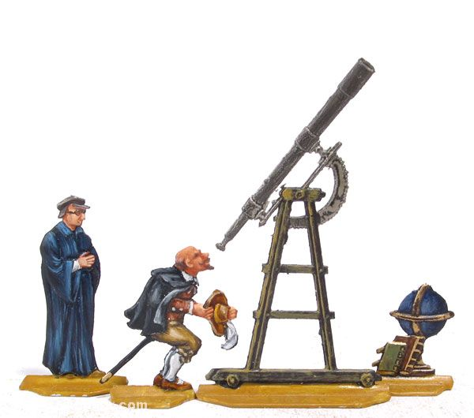
Disclaimer
Although I had the privilege to lead efforts in almost all science-driven operations and technology domains ESO has entrusted astronomers with, I have not been directly involved in the E-ELT project.
And the talk hasn’t really been updated for two years.
Listen at your own risk. Reduce it by asking questions!

Slide 3
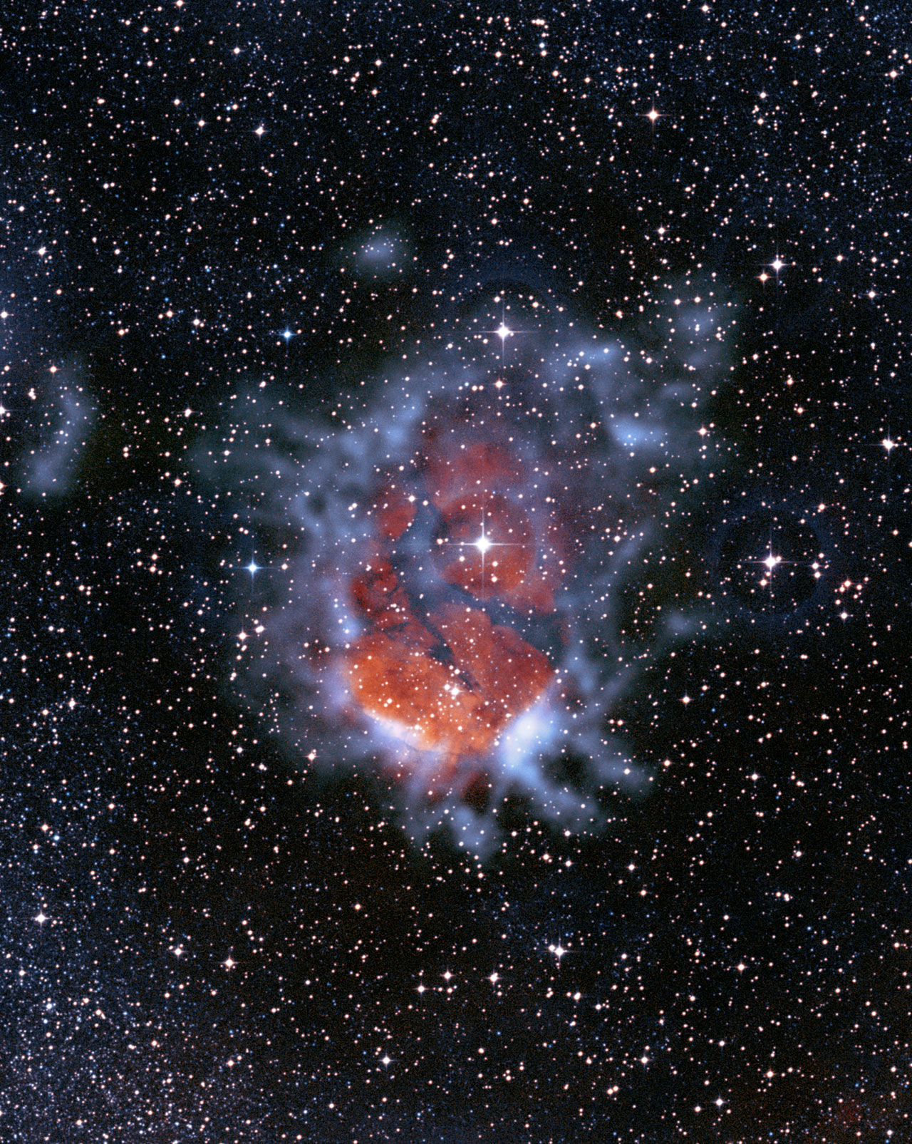
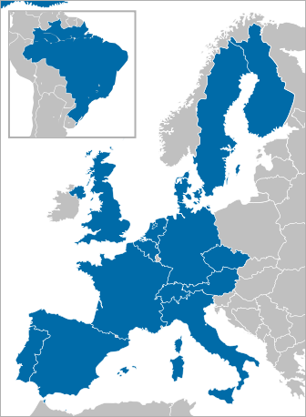
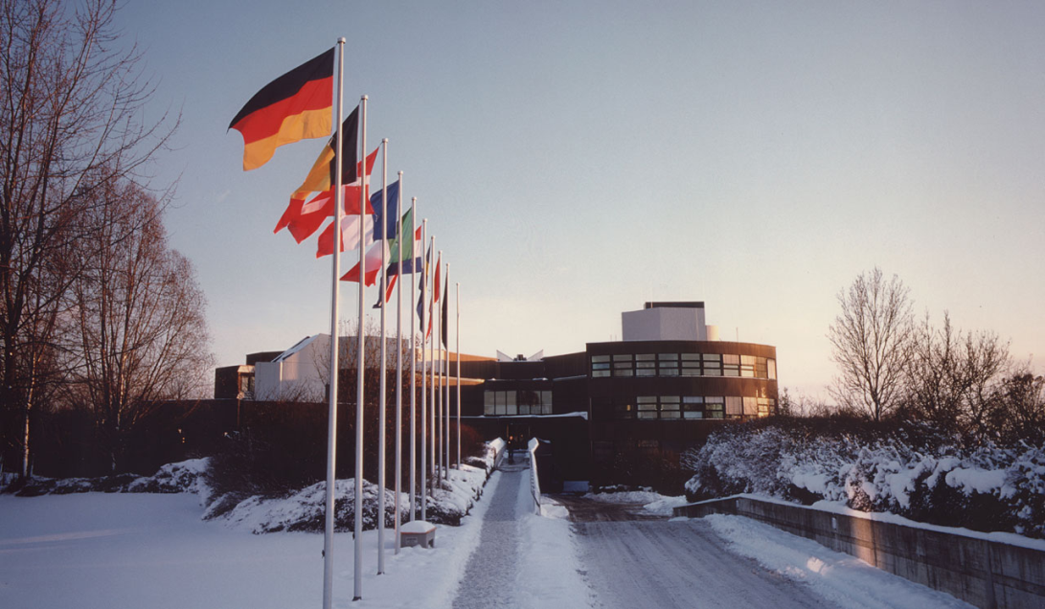
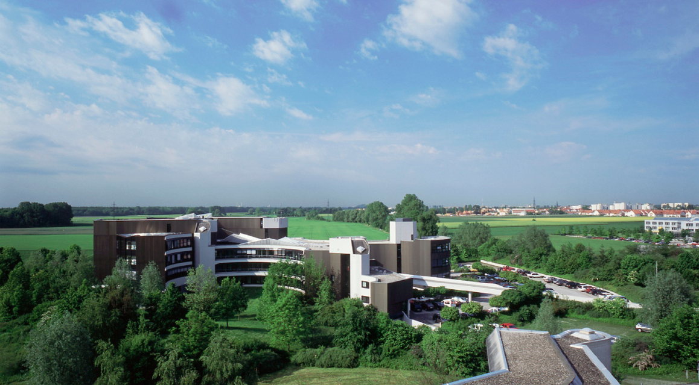
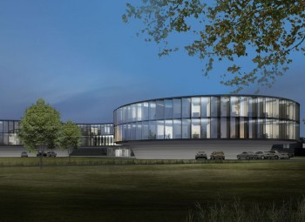
The European Southern Observatory in a Nutshell
Intergovernmental organisation (founded in 1962)
14 member states + Brazil
Annual budget: ~135 million €
Number of staff: ~700
2 x 900 proposals/year (w/o ALMA)
850 refereed papers in 2012 (w/o ALMA)
Headquarters in Garching (Germany)
Observatories in Chile
(+ Poland?)

Slide 4
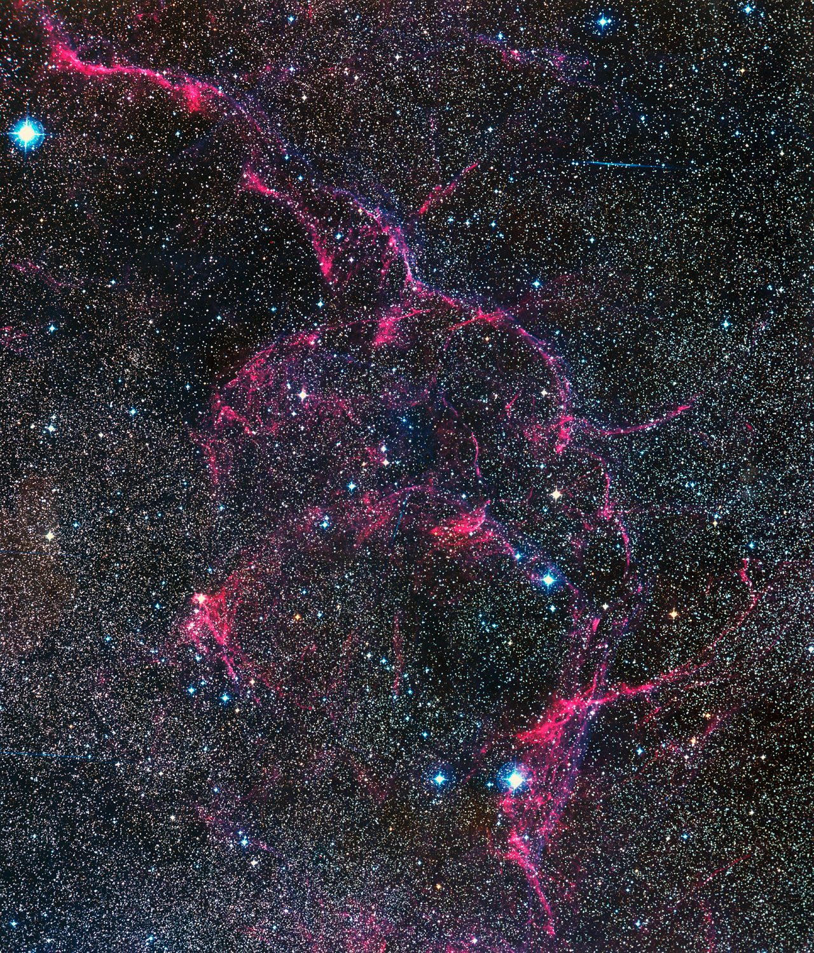
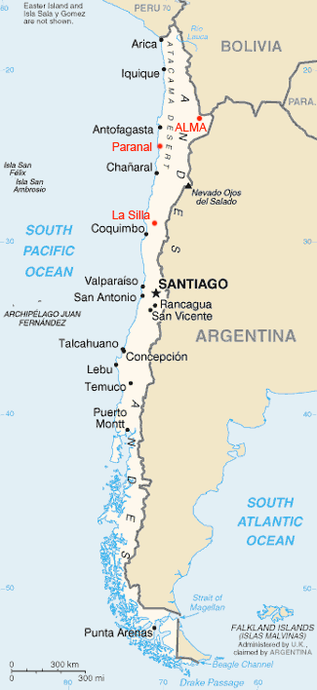
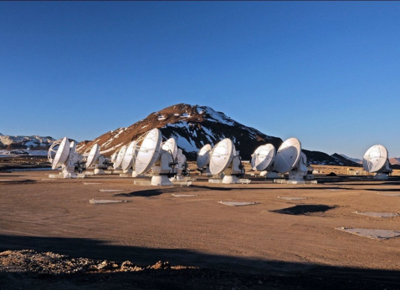
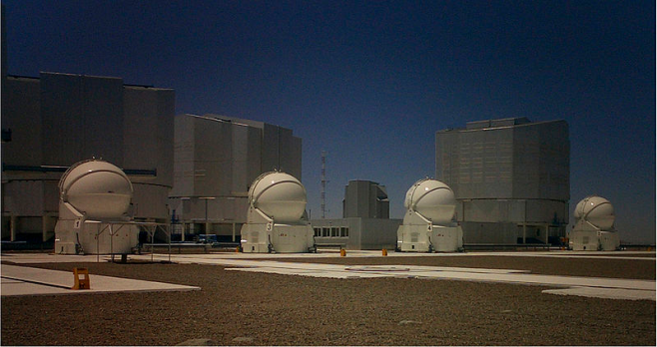
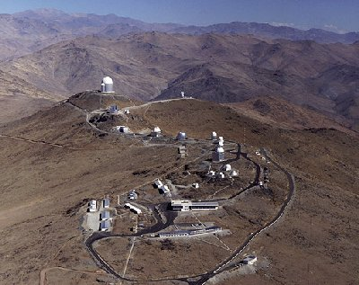
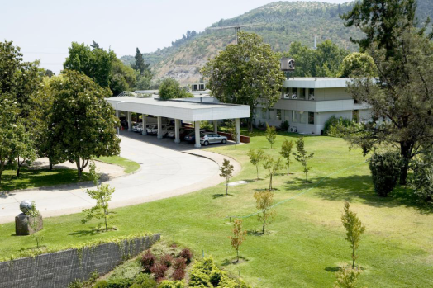
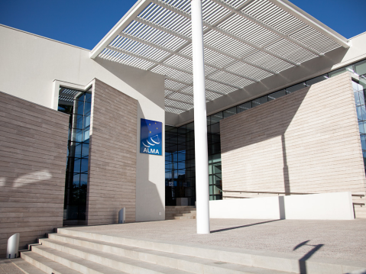
ALMA (Chajnantor)
VLT (Paranal)
ESO @ Chile
La Silla
ESO (Santiago)
Joint ALMA Office (Santiago)

Slide 5
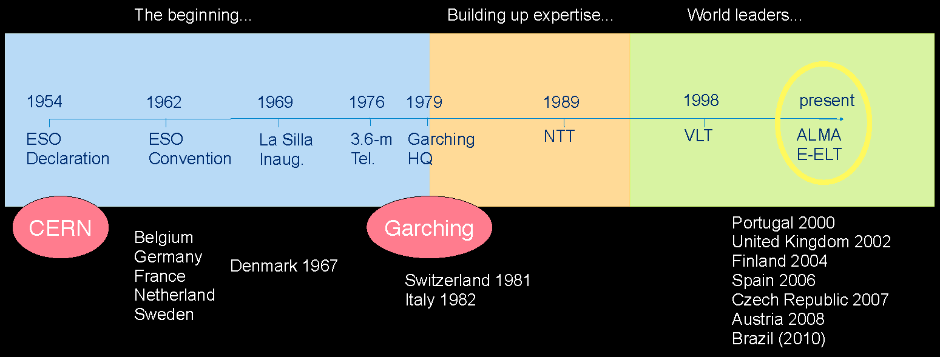
A shorter history of ESO

Slide 6
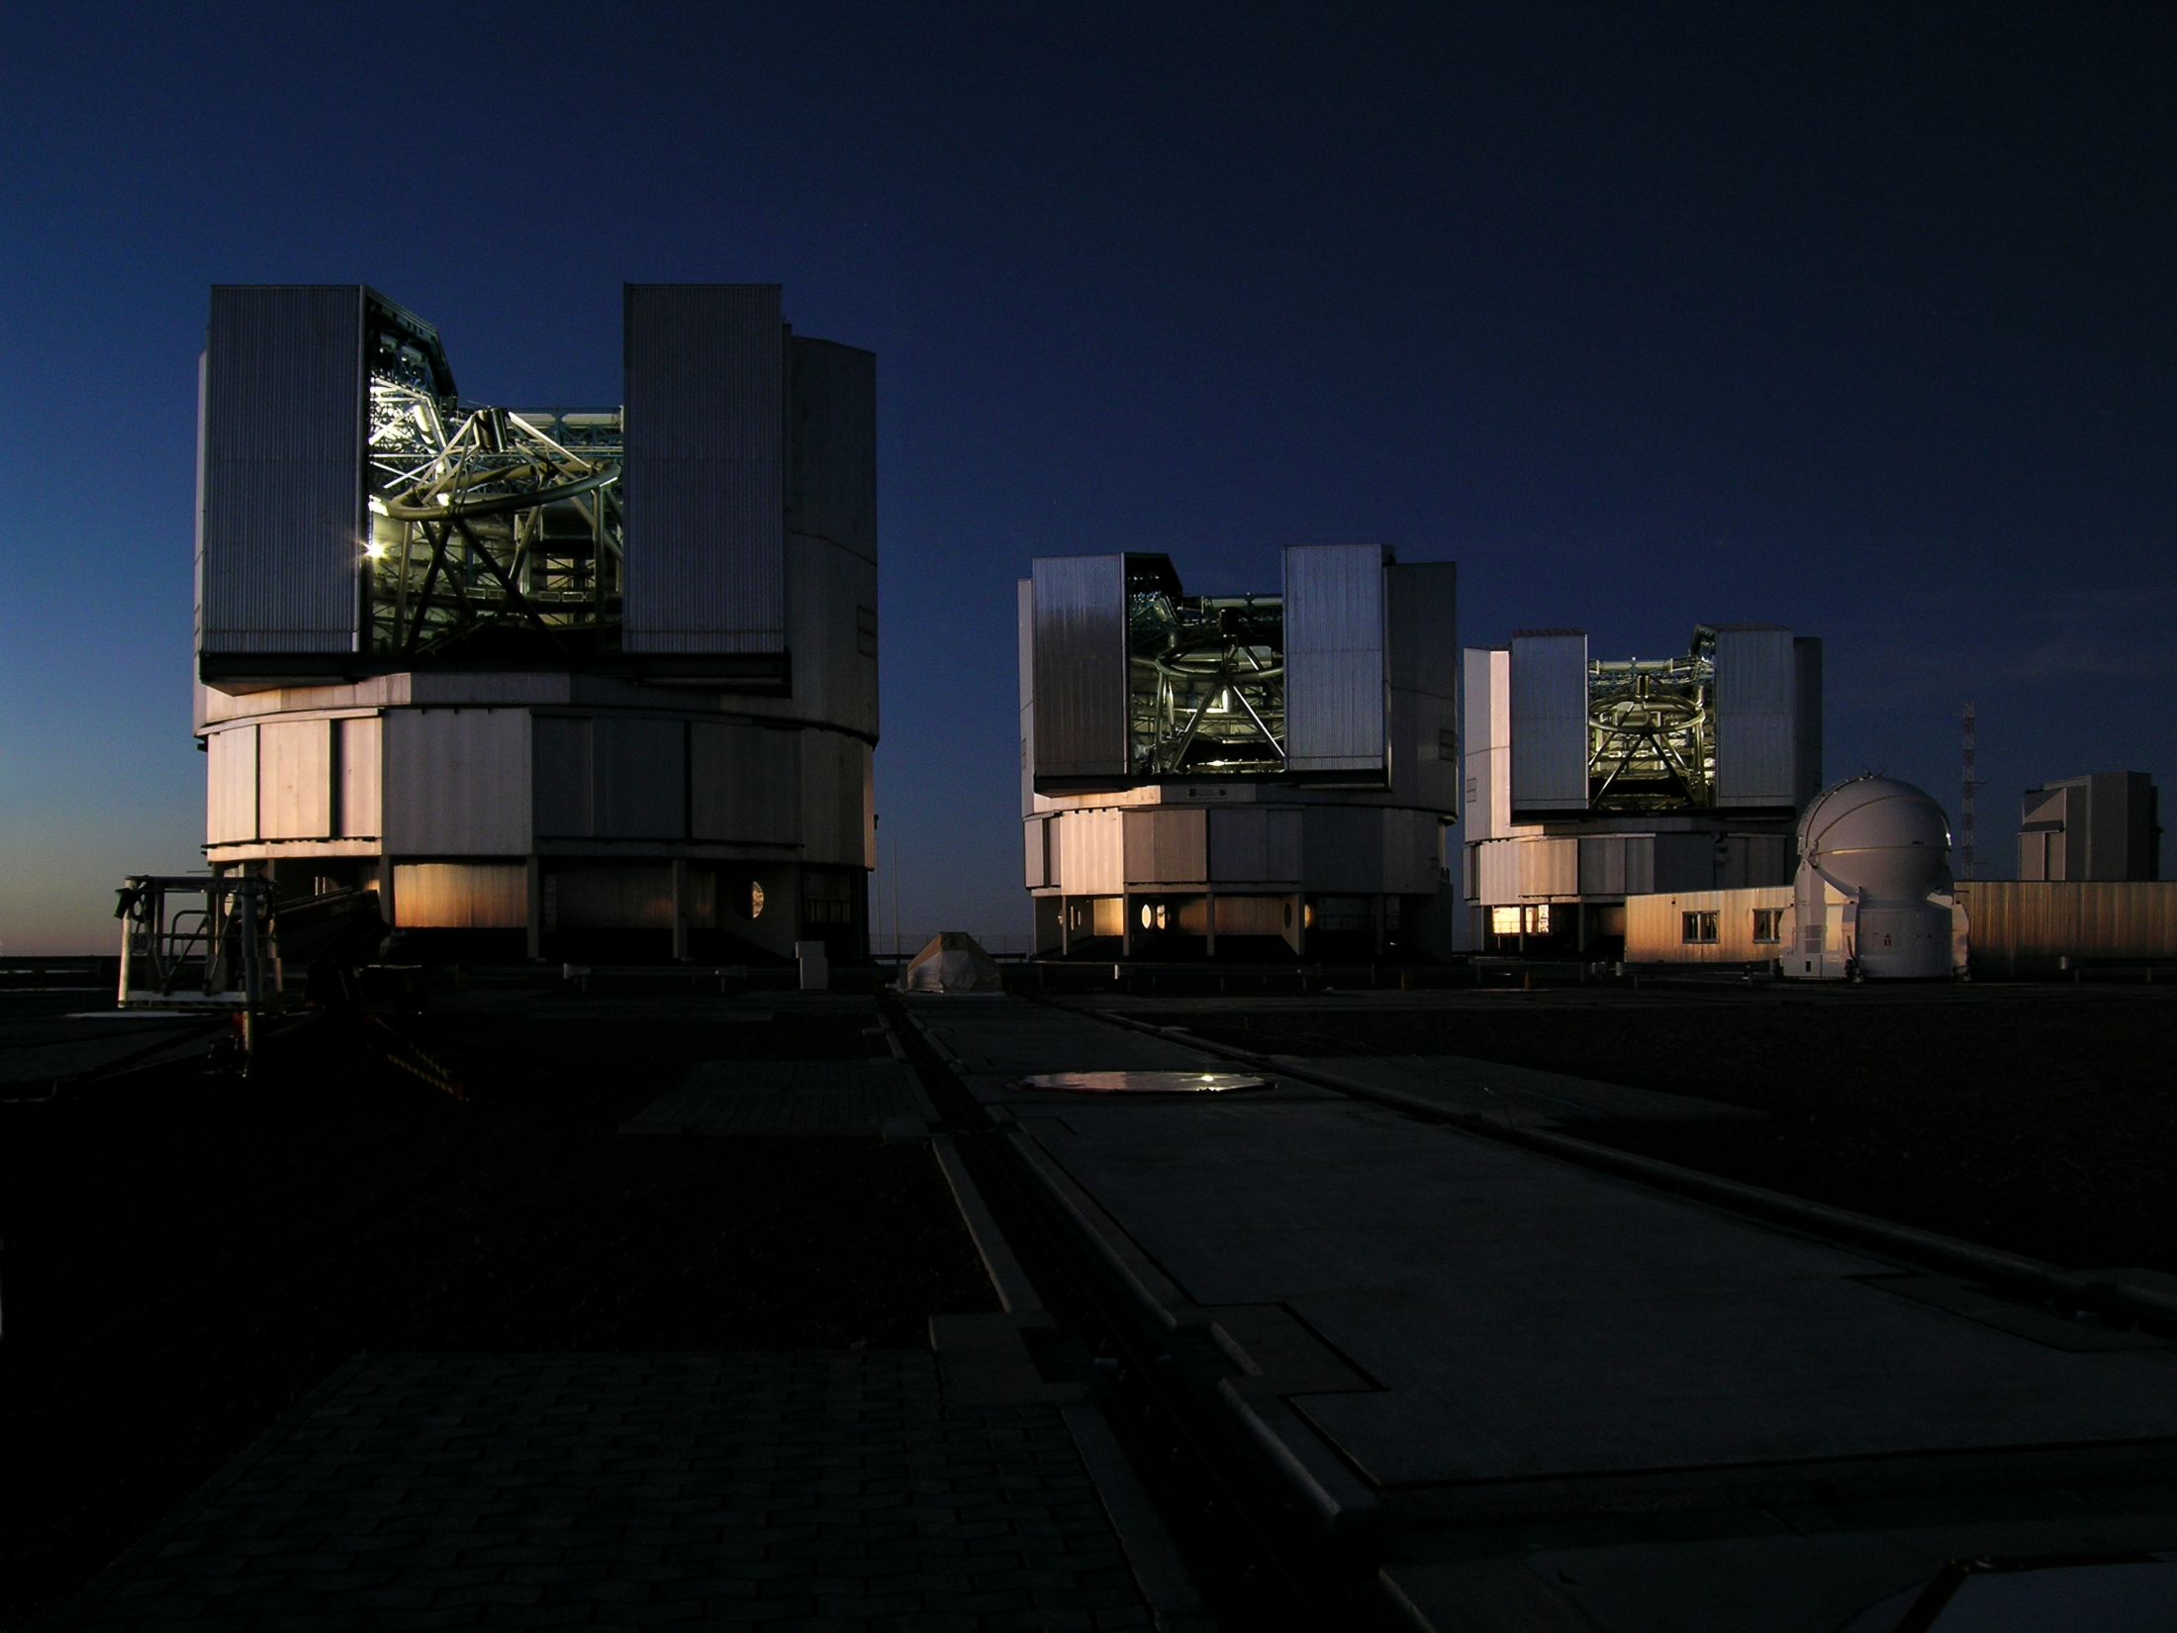
This is the most powerful astronomy machine on Earth.
Why raise a billion Euros to build a new one?
ESO’s VLT Observatory on Cerro Paranal (Chile)

Slide 7
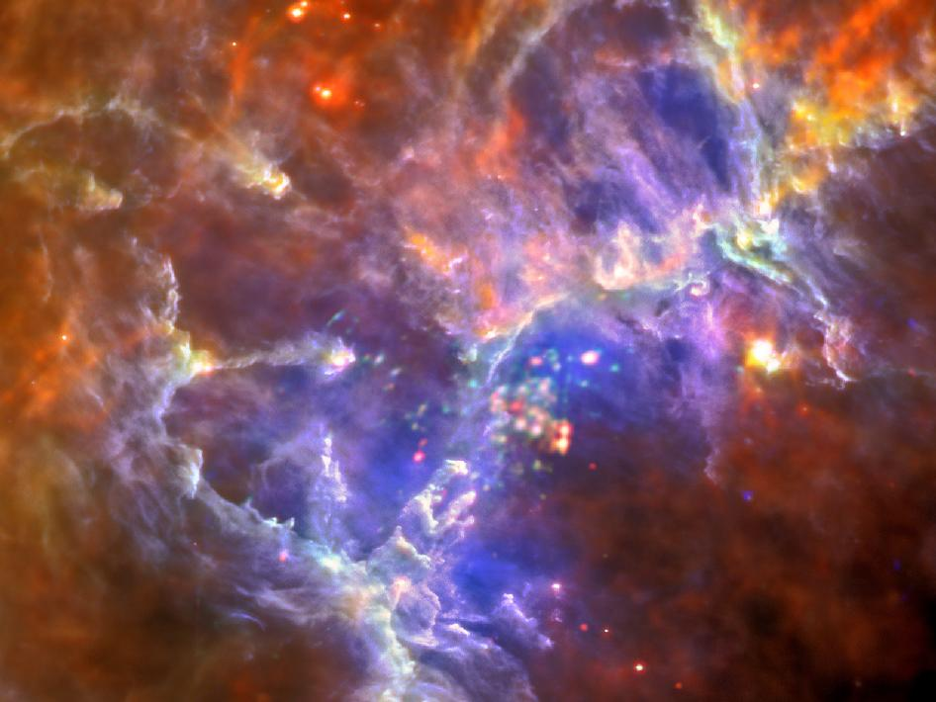
Scientific answer: The Very Large Telescope (VLT) and many other ground-based and space-borne observatories have uncovered exciting new facts, e.g.:
The Universe expands at an increasing pace.
But we do not know why.
Galaxies assemble from primeval gas and stars.
But we do not know how and when.
The Universe abounds in planets.
But we do not know whether any of them carry life.
These are facts.
But their understanding requires deeper data.

Slide 8
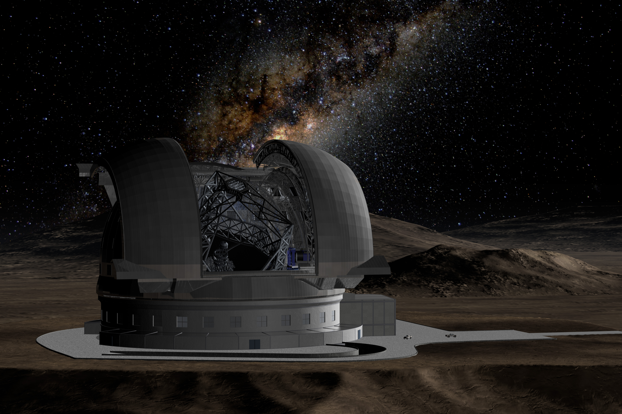
Only Extremely Large Telescopes can supply such data and help to convert them to understanding.
The three examples form the core of the science case for the E-ELT.
Because the Very Large Telescope (VLT) and many other ground-based and space-borne observatories have uncovered exciting new facts, e.g.:

Slide 9
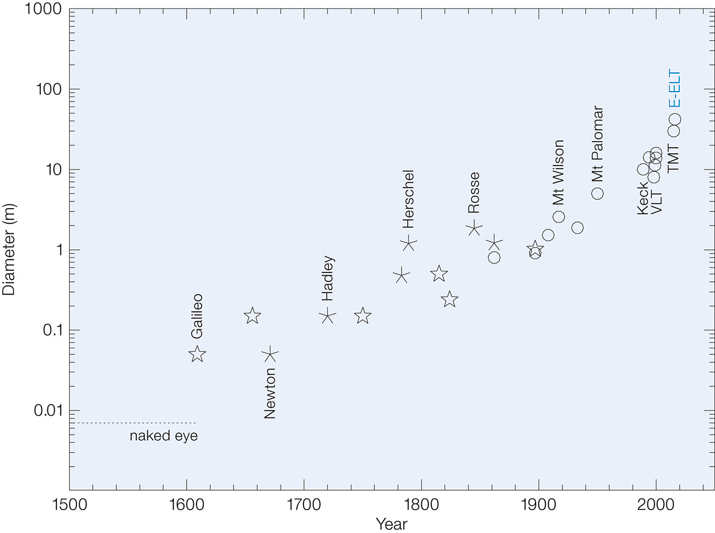
Technical answer: Moore’s law for optical telescopes
O Glass reflector
Speculum (metal) reflector
Refractor

Slide 10
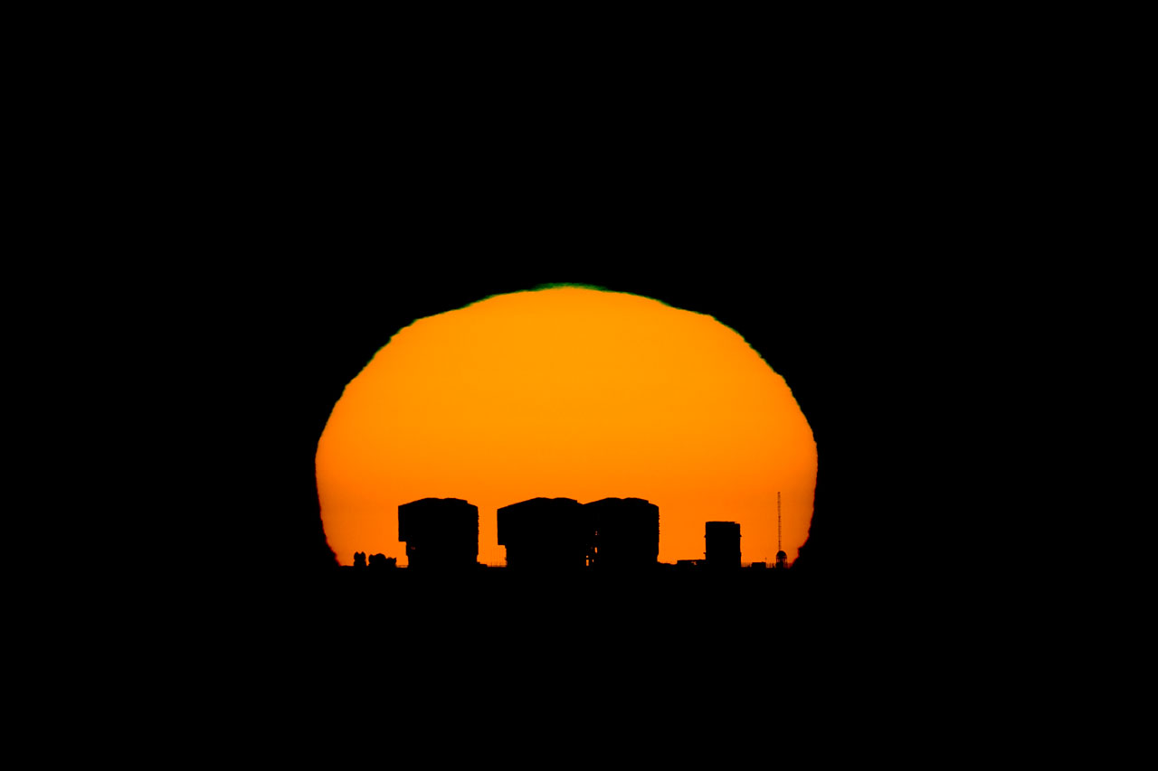
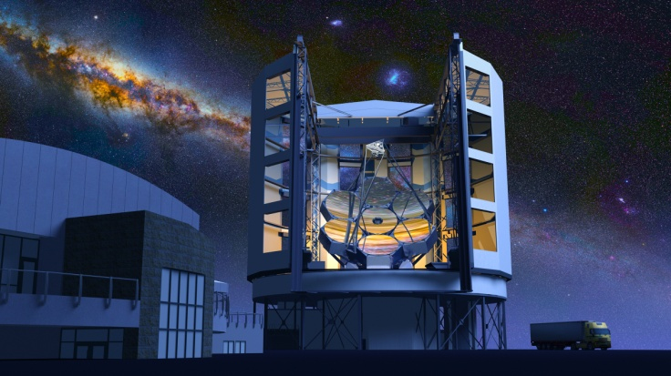
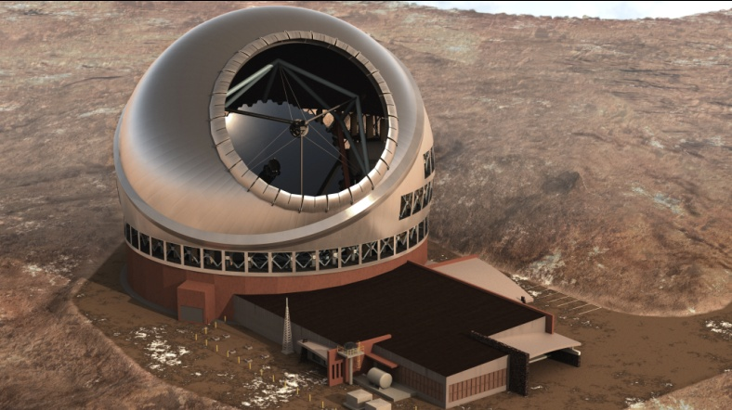
Evolutionary answer: Of course, the VLT will be topped eventually

Slide 11
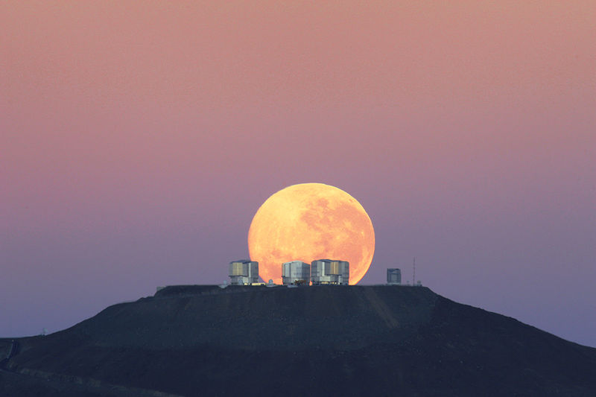
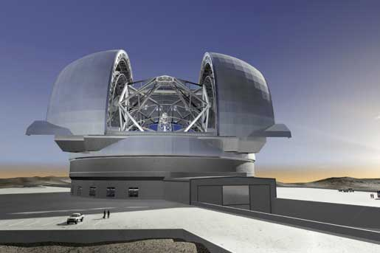
The ESO community will undertake every possible effort that it is not itself topped.

Slide 12
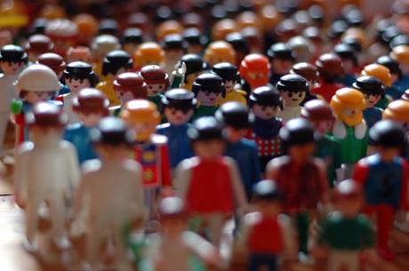
Community

Slide 13
ESO and its Community: People
About 2500 astronomers working at ~150 institutes.
Nearly 110 astronomers at ESO.

Slide 14
ESO and its Community: Money
A large fraction of the financial resources available in Europe to ground-based astronomy goes to ESO.
=> ESO must support a very broad scientific menu.
The European ground-based astronomical community receives a not negligible fraction of its funding for engineering efforts from ESO - especially through the instrumentation programs.
ESO also awards generous amounts of GTO to instrument consortia.

Slide 15
ESO and its Community: Facilities and Platforms
ESO develops and operates world-class facilities on behalf of its community.
The community enables this process by providing world-class instruments.
ESO provides frameworks for common infrastructure (e.g., archive, data flow system, control system, technical standards, detector systems).
The community uses these tools and contributes new applications.
ESO consolidates, amplifies, and disseminates them.

Slide 16
ESO and its Community: A Network
There is permanent substantial give and take between ESO and its community.
Every such exchange adds extra value.
ESO’s good relations to industry form the third pillar.
Recipy against ‘agency syndrome’: If it can be done outside ESO, try that first.
This ‘ESO process’ is a complex and ever more tightly woven highly successful network of distributed and shared experience and mutual confidence.

Slide 18
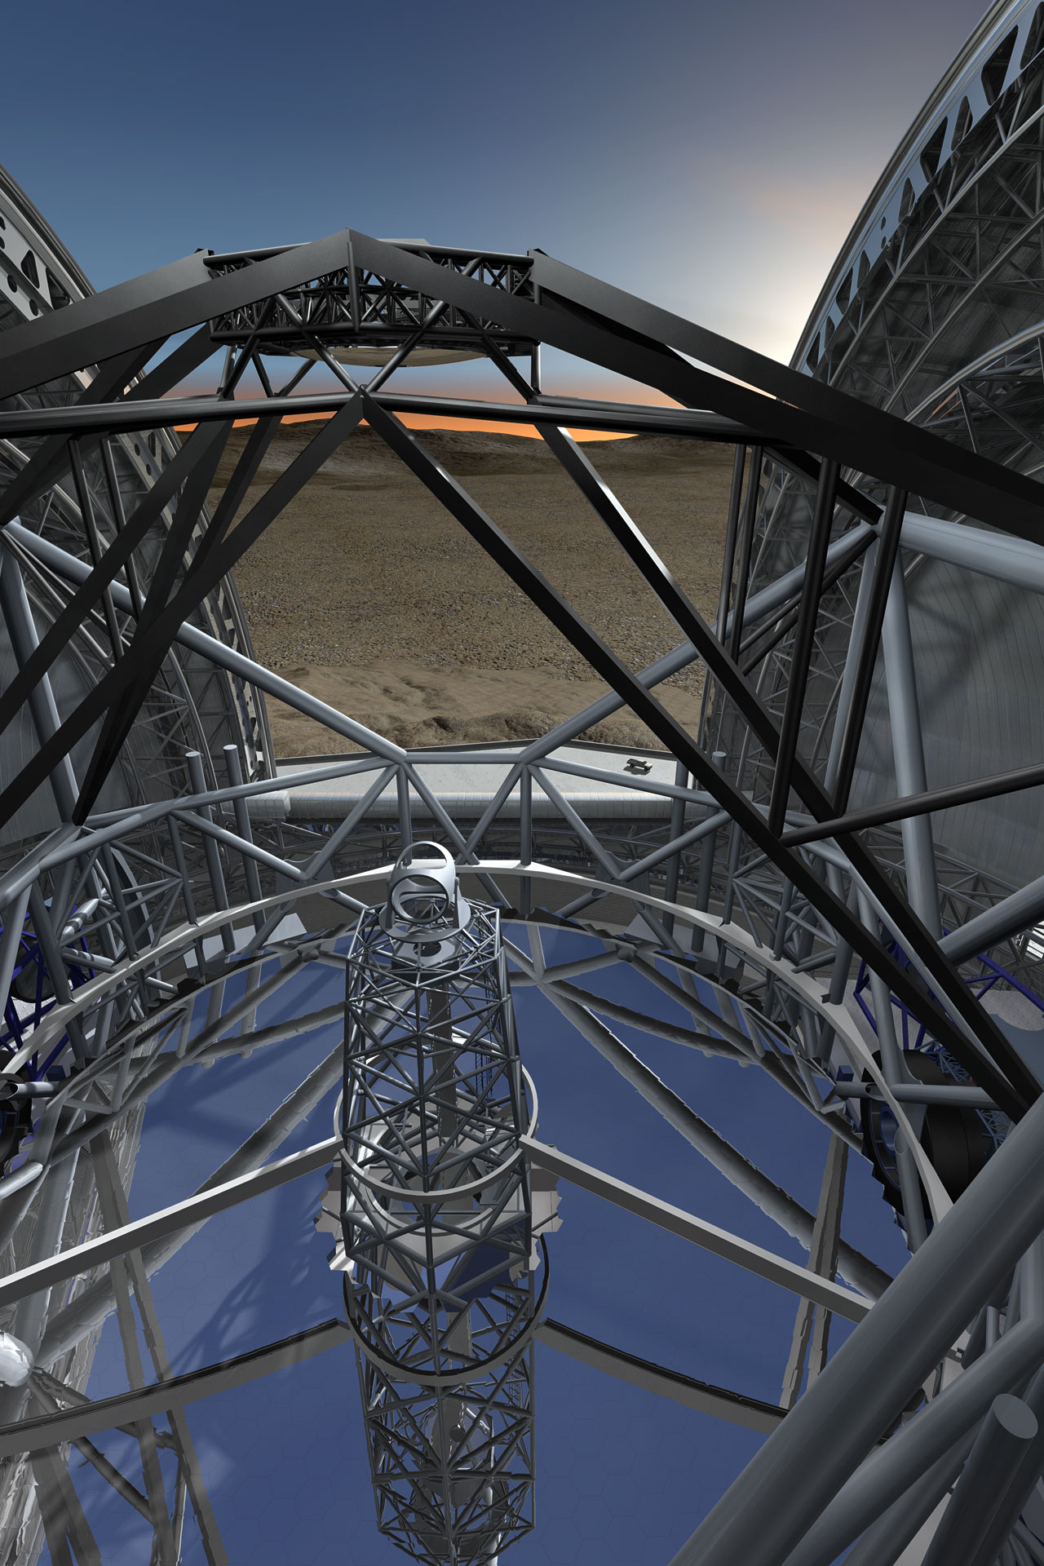
The European Extremely Large Telescope
Most ambitious optical telescope ever built
Primary mirror of ~39 m diameter
Working at optical / infrared wavelengths
Built-in adaptive optics with 6 lasers - diffraction limited
Status: Handed in construction proposal after detailed design phase (B)
Start construction 2012 - first light in 2021
Construction cost
Telescope 883 M€
Contingency 100 M€
Instruments 100 M€

Slide 19
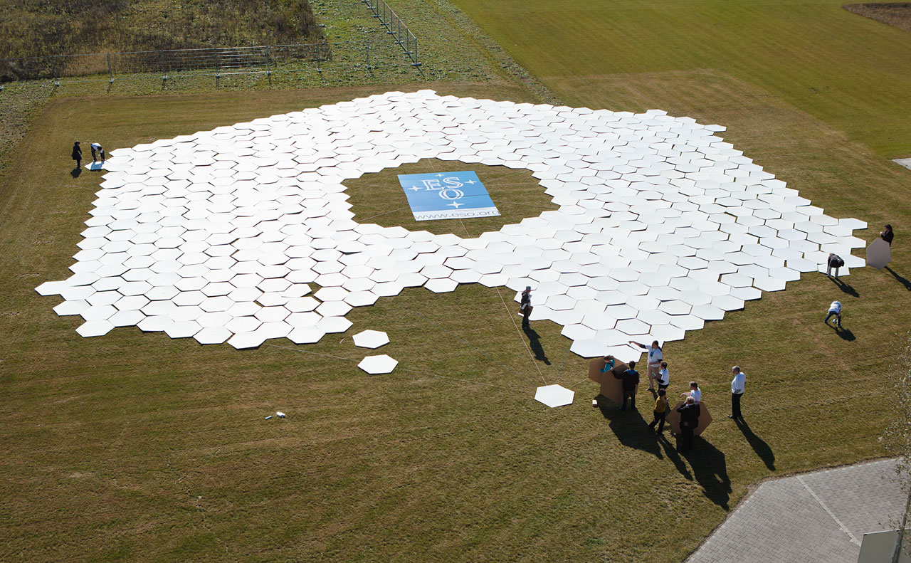
The E-ELT primary mirror in real life size

Slide 20
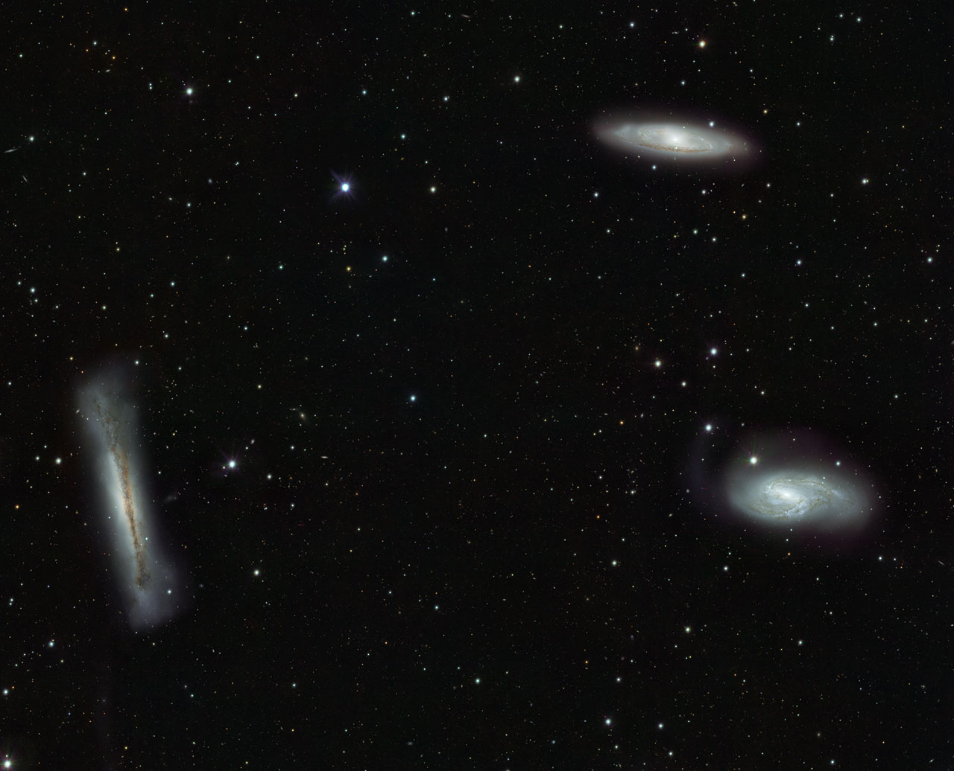
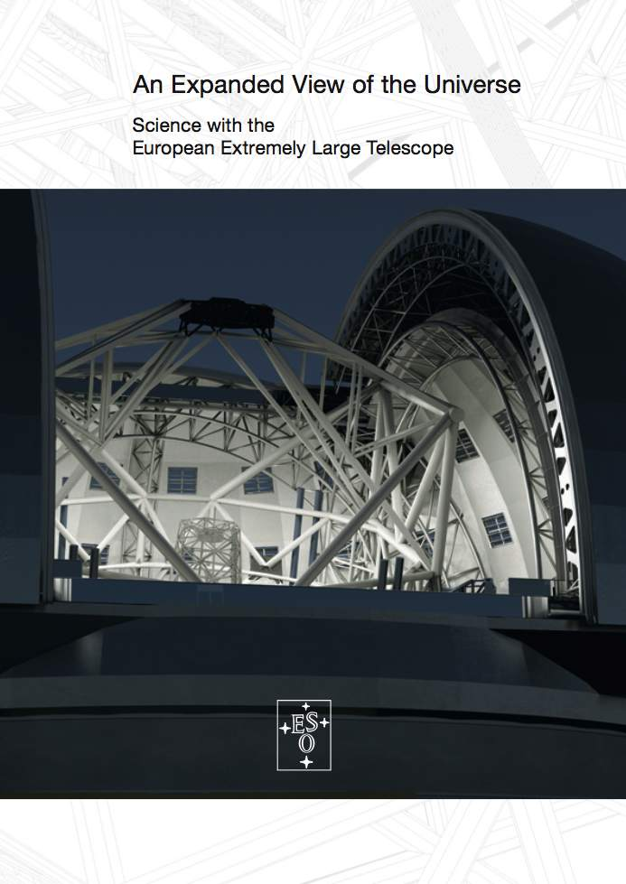
The E-ELT Science Case:
Available at: www.eso.org/sci/facilities/eelt/science/

Slide 21
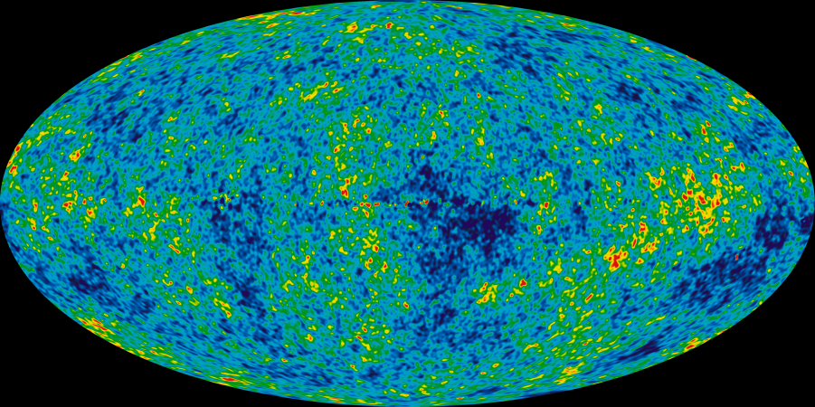
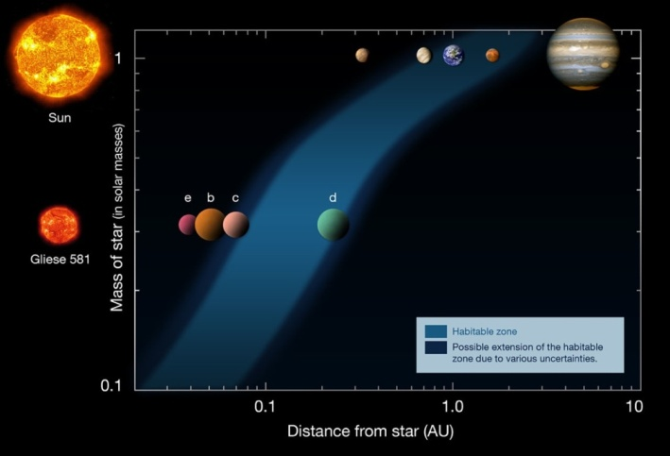
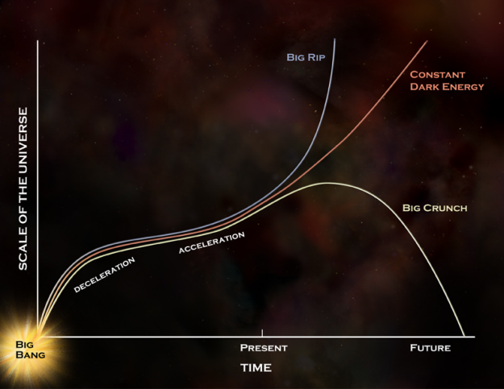
The E-ELT is conceived as a multi-purpose observatory that, from the start of operations in a decade, shall remain at the forefront of science for 20-30 years.
It is challenging to anticipate the science needs in 2050
(today’s PhD students will retire around that time).

Slide 22
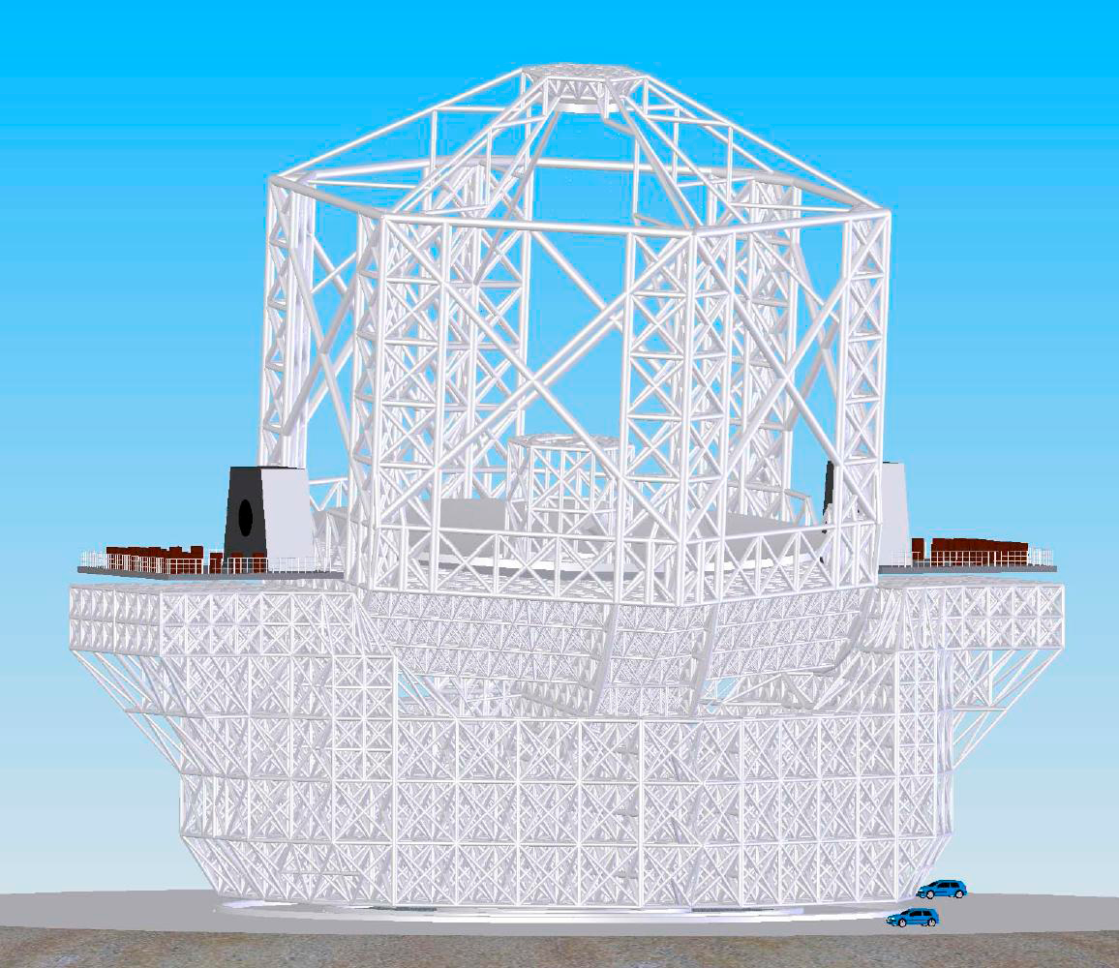
Therefore, the E-ELT Science Case is as broad and diverse as its users community. The project carries
A dozen detailed science cases
(=> Design Reference Mission)
Nearly 200 community-provided sciences cases
(=> Design Reference Science Plan)
The scientific requirements rest on three pillars:
Contemporary science
Synergies with other world-class facilities
Discovery potential

Slide 23
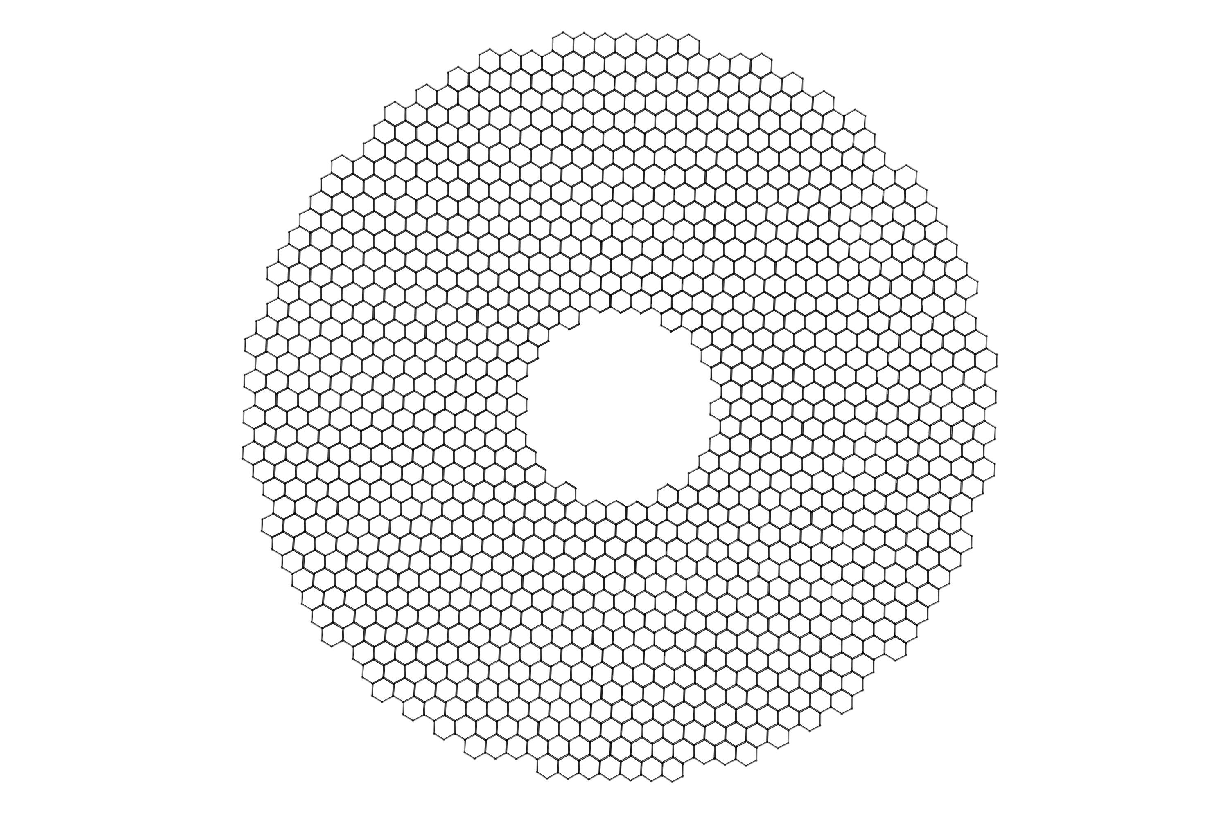
Size really does matter (I)
Larger fainter, farther, earlier than with VLT (“citius, altius, fortius”)
Almost 25x larger light-collecting power (D²)
At Strehl of 1, almost 600x more sensitive for background-limited point sources (D⁴)
Galaxy formation
Can reach SNe Ia at z > 4 (90% look-back time)
Nucleocosmochronology
Full WD cooling sequence in GCs
…
New frontiers

Slide 24
Size really does matter (II)
Larger better than with VLT
Resolve stellar populations in Virgo supercluster
(nearest massive early-type galaxies)
Constrain variation of fundamental constants (α, μ, etc.)
…
New opportunities

Slide 25
Size really does matter (III)
Larger more precise than with VLT
Sun/Earth-like star/exoplanet systems
Stellar reflex velocity: 10 cm/s
Contrast: 10¹⁰ over 0.1 arcsec / 0.5 mm (10 pc)
Acceleration of expansion of Universe
Signal in Lyα forest in quasars: 1 cm/s/yr
Model-independent method
…
New worlds

Slide 26
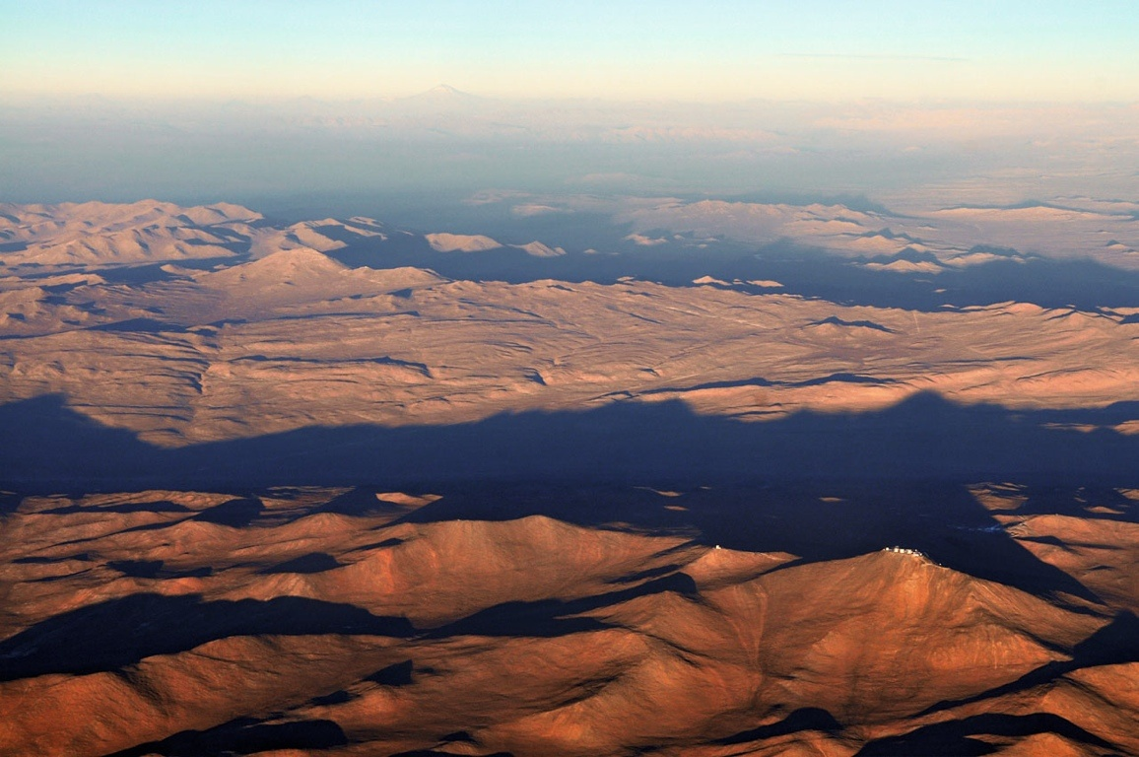
Armazones
(E-ELT site)
Paranal
(Combined E-ELT/VLT Operations Center)

Slide 27
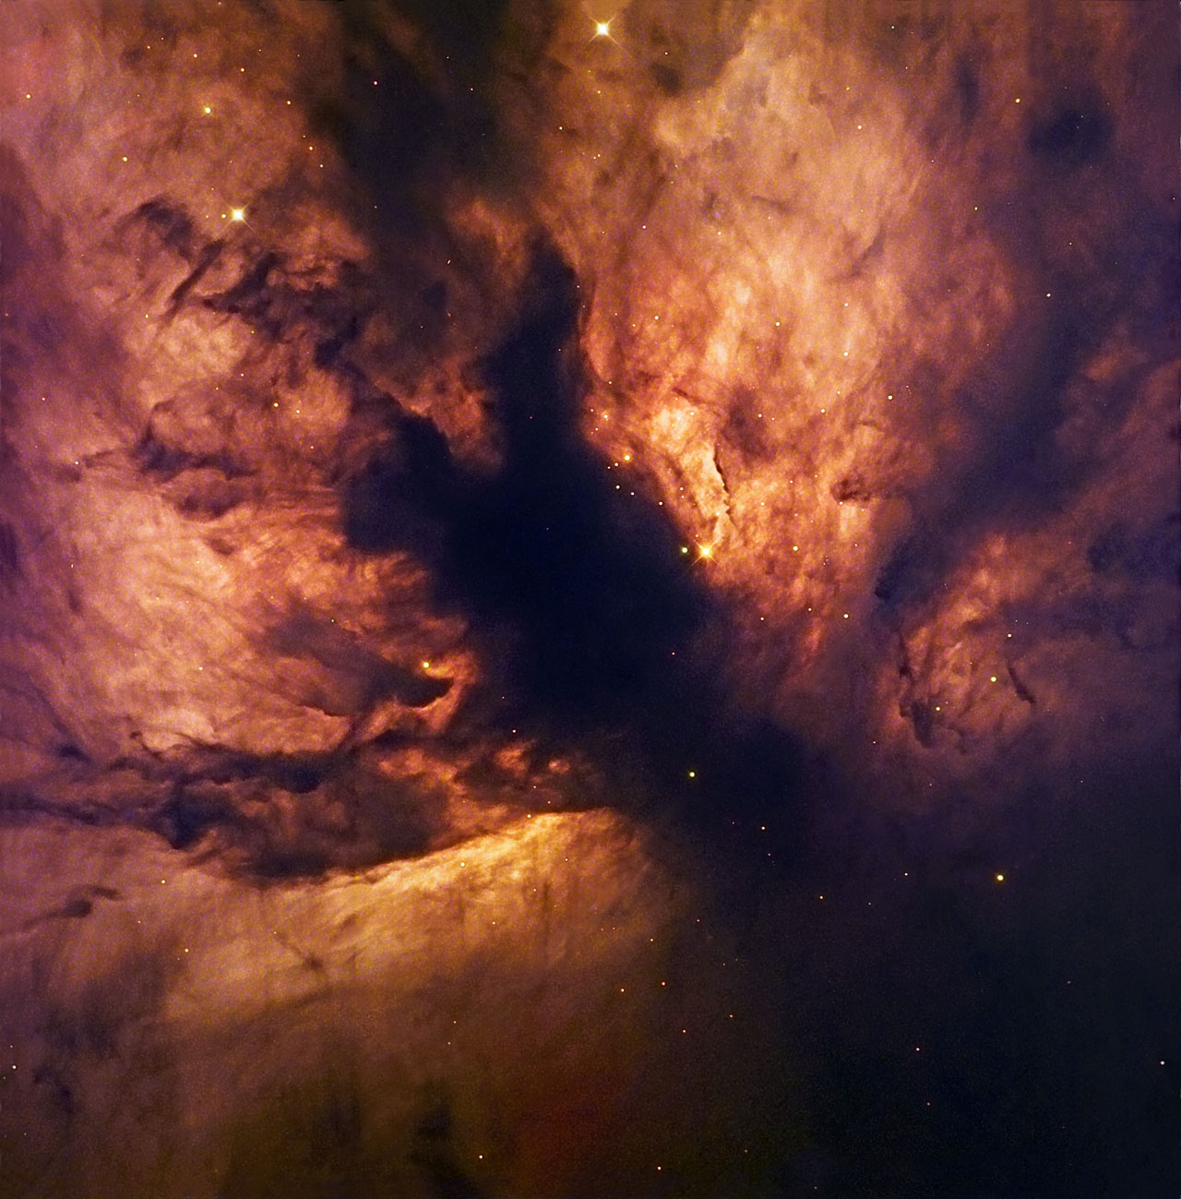
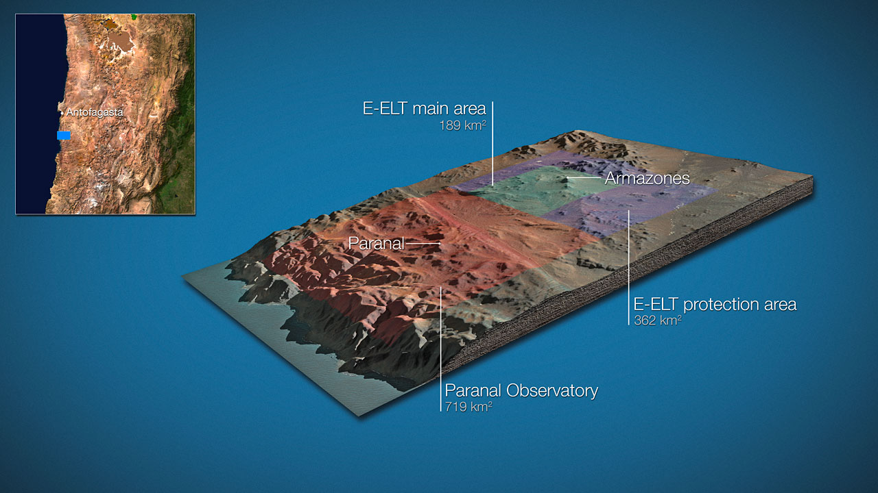
Northern Chile
~ 22 km

Slide 28
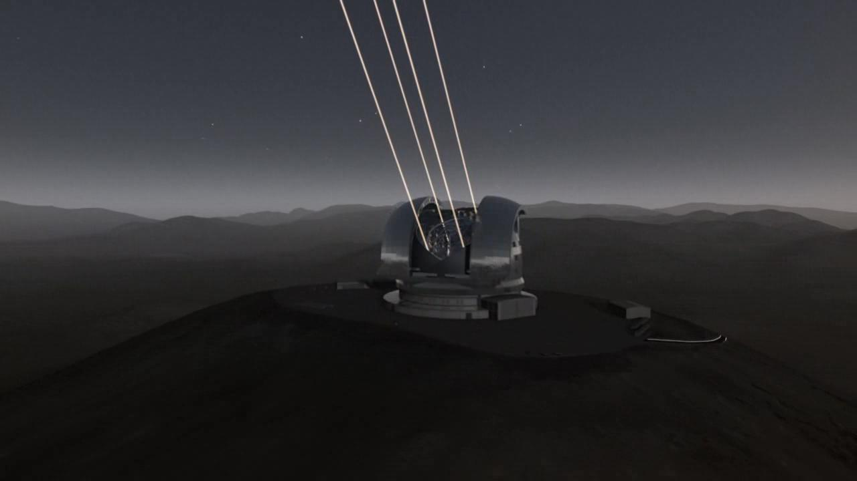
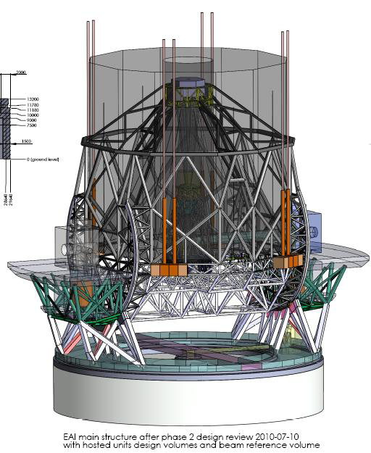
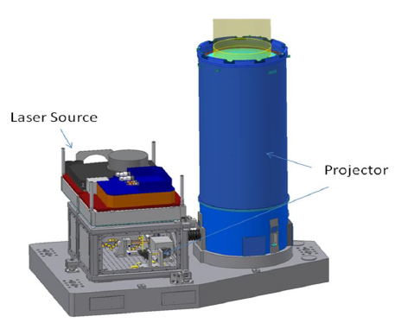
8-m VLTs may (or may not) use adaptive optics (AO)
ELTs fail without AO: AO is built-in feature of E-ELT
Sky coverage much improved
with laser guide stars

Slide 29
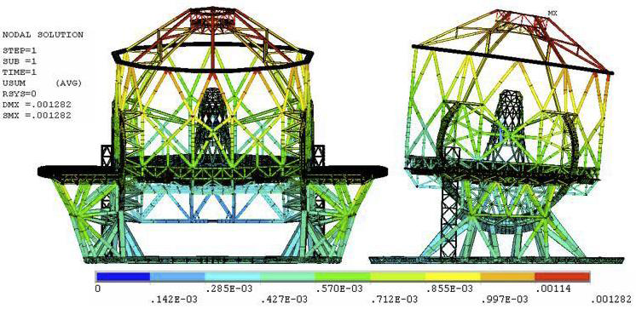
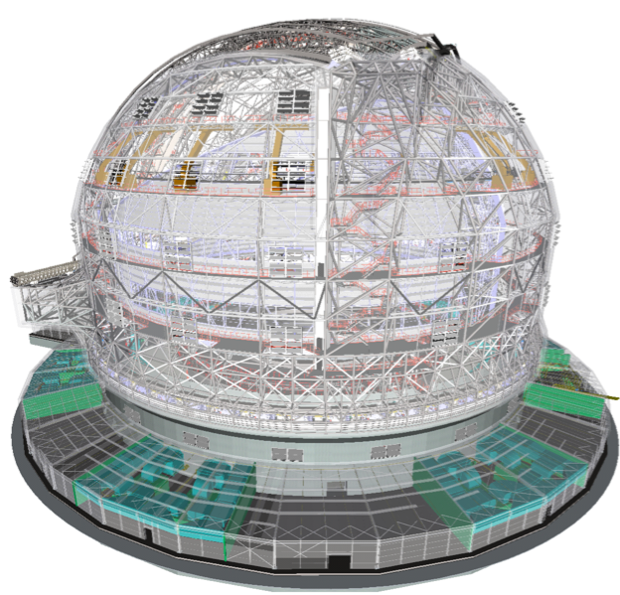
Main structure:
alt-az mount, 2800 t
Dome:
80 m x 90 m Ø
65,000 m³
fully air conditioned

Slide 30
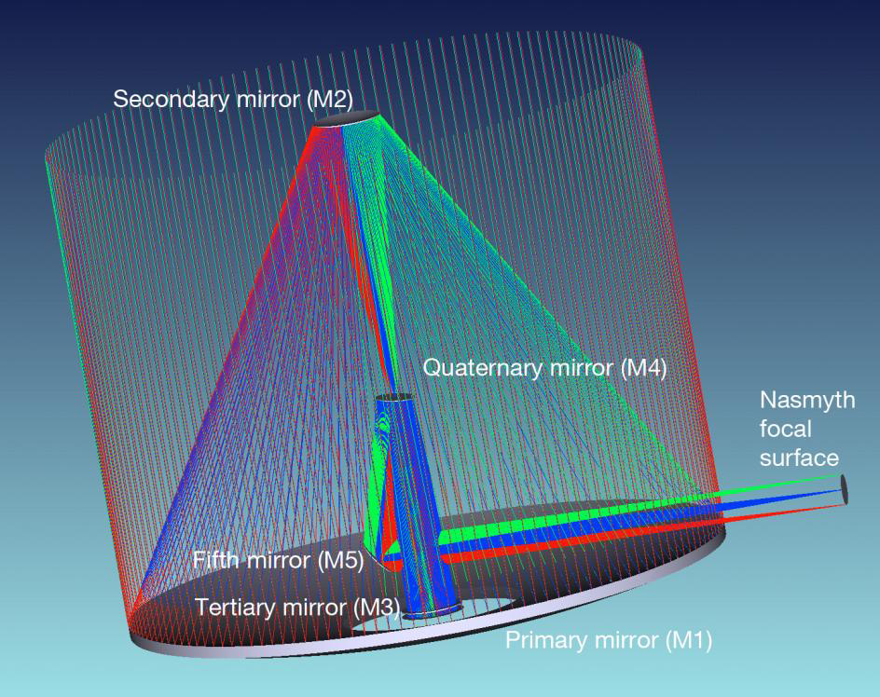
Novel 5-mirror optical design
4.3 m
4.2 m
2.5 m
2.4 m
2.2 m x 2.7 m
3.7 m
39 m
Three mirror anastigmat + two flat mirrors (M4, M5)
Strehl > 99% out to 3’ radius for λ > 360 nm
50 mas
Axis
5 arcmin
Diffraction limit at 1 μ: 5 mas

Slide 31
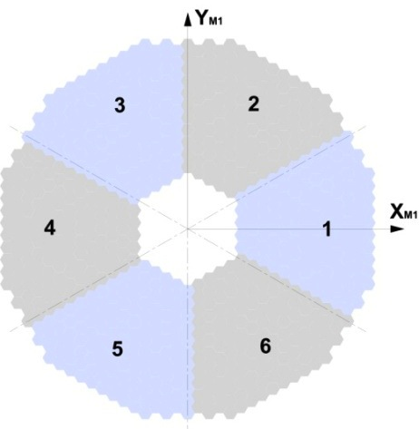
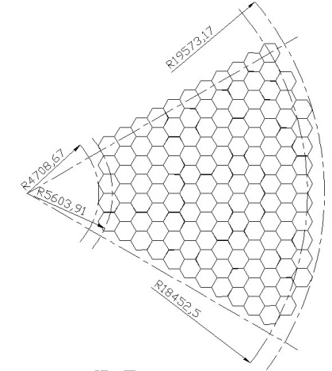
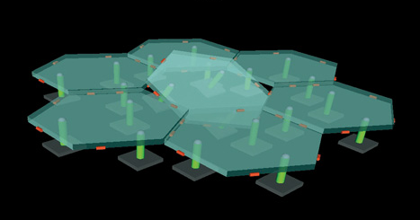
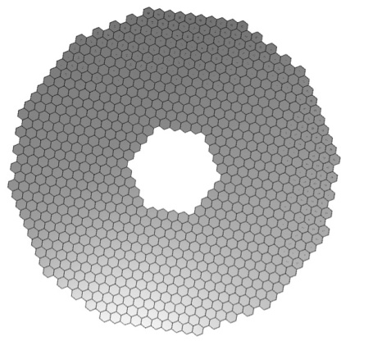
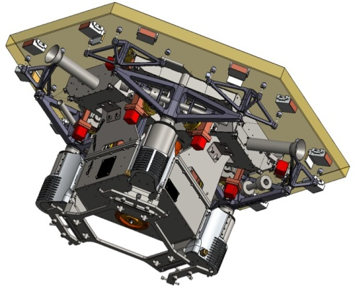
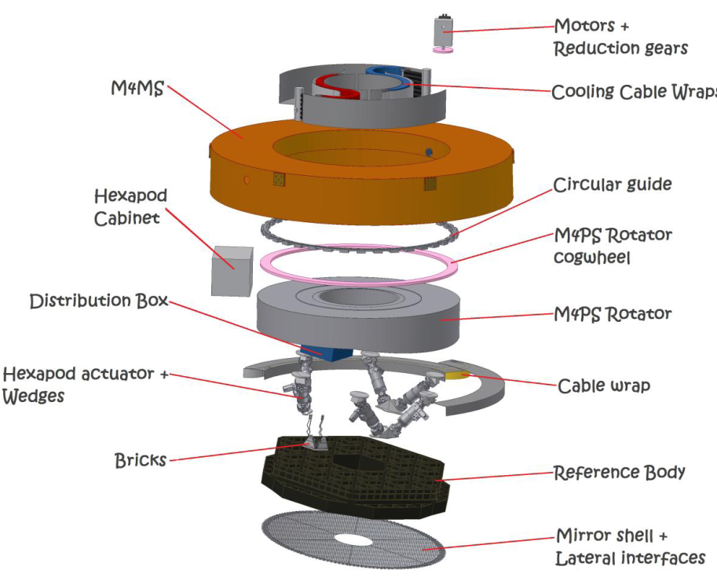
M1: F/0.93, 39 m diameter
798 segments, 1.45 m average size
(corner to corner), 50 mm thick
6 sectors of 133 segments each + 1 spare set – 931 segments total
Each segment controlled in piston / tip / tilt
Each segment controlled in shape
4-mm gaps
M4: flat, 2.5 m diameter
Zerodur 2 mm thin shell
5790 contact-less actuators
207 removable actuator bricks
700 Hz
Fitting error 145 nm rms
@ 0.85” seeing
10 tons, 8.4 kW

Slide 32
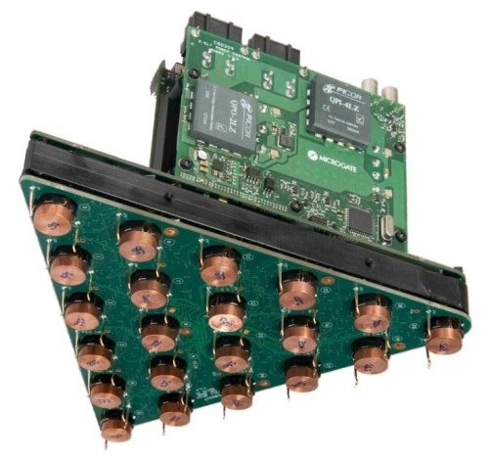
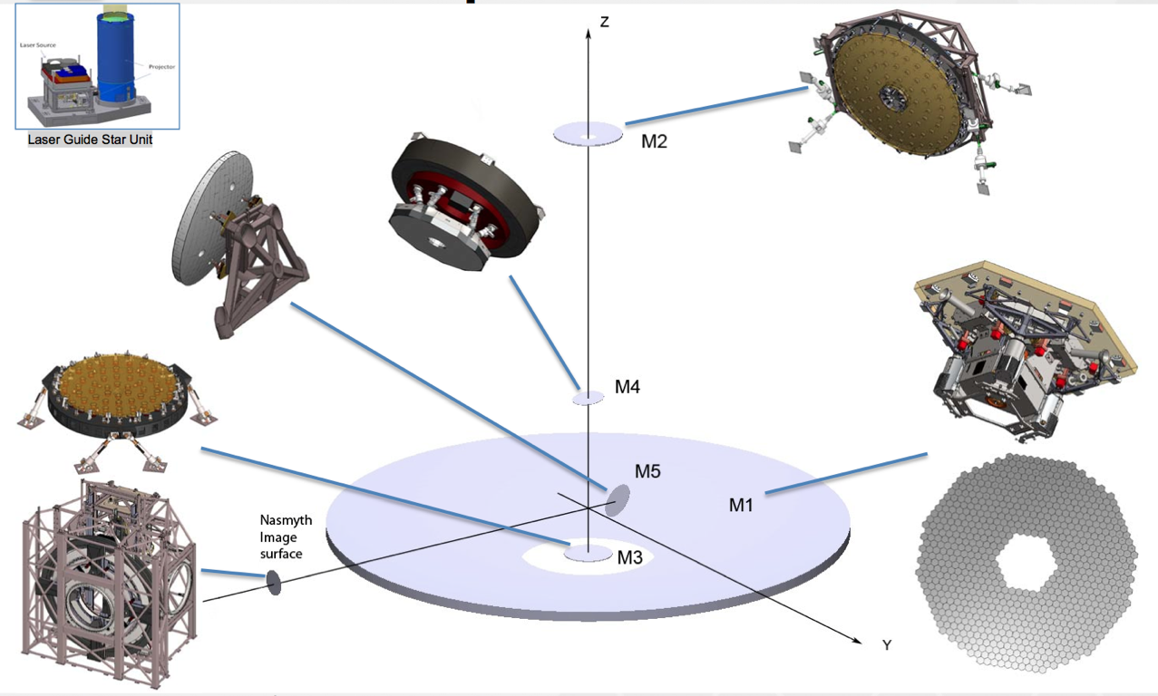
M4 support and “brick”
Raman fiber laser (VLT AOF)
M4 hexapod
Wavefront sensors
M1 support
Deformable mirror (VLT AOF)
M5 support
M5 structure
Have prototyped all critical parts
Control system
M1 segment

Slide 33
E-ELT Assembly Sequence

Slide 34
Mirror-segment active-phasing experiment

Slide 35
Detailed design phase completed with:
Full technical review by an external panel
(including representatives from TMT and GMT projects)
Full cost review by an external panel
Full cost and cost-benefit review by a major European
consulting company (at the request of ESO Council)
All (very) successfully passed.
The detailed design phase also furnished the material to tender (or the offers to supply) the major components of the project: dome, main structure, M1, M4.

Slide 38
Risk mitigation
Technical:
Have prototypes and/or firm offers for all critical components
No major R&D effort needed; use today’s technologies
Financial:
Have fixed-price offers for 473 M€ of the total cost.
Contingency of 100 M€ corresponds to nearly one-quarter of the remaining cost.

Slide 39
Funding
Three-thirds rule of thumb (applied over 10 years):
1/3 from member states: Inflation-adjusted contributions increase by 2% per year.
1/3 from savings in ESO budget.
1/3 from new members states.

Slide 40
E-ELT Instrumentation Plan
Community and ESO conducted Phase A studies for eight instruments and two adaptive optics modules (2007-2010)
All near- and thermal infrared instruments aim for exploiting E-ELT diffraction limit
+ MAORY (MCAO)

Slide 41
Implementation of Instrumentation Plan
1st light instruments
2nd group
~30 m
Nasmyth platforms A & B

Slide 42
Level of Community Involvement (FTEs)

Slide 43
Are ELTs dinosaurs and bound to become extinct?
No. Actually, dinosaurs were the most successful group of animals on Earth: They did not become extinct because they were too large.
Their gigantism was due to their cold-bloodedness.
VLT
ELTs will be kept cool and can and must be giants.

Slide 56
The E-ELT is one of the most carefully prepared major science facilities ever, thanks to enormous joint efforts by community and ESO.
The project is now proceeding to the construction phase.

Slide 57
Available at:
http://www.eso.org/sci/facilitieseelt/
docs/e-elt_constrproposal.pdf

Slide 59
Disclaimer
Although I had the privilege to lead efforts in almost all operations and technical areas ESO entrusts astronomers with, e.g.:
High Resolution Spectrograph (@HST) Instrument Scientist (STECF)
Head, User Support at Headquarters
Head, NTT Team and NTT Upgrade Project Manager
VLT Science Operations Plan
Head, Mid-sized Telescopes Team
ESO Project Scientist and Manager for Wide Field Imager (8K x 8K)
Head, Optical Detector Team
ESO Project Scientist and Manager for OmegaCAM@VST (16K x 16K)
Head, Instrument Scientists Department
ESO Project Scientist for CRIRES Upgrade, 4MOST, and MOONS
I have not been directly involved in the E-ELT project.
And the talk hasn’t really been updated for two years.
Listen at your own risk. Reduce it by asking questions!

Slide 60
Main scientific interests:
Be stars (Carciofi, Martayan, Rivinius, Štefl, et al.)
(Nonradial) pulsations
Mass loss
Structure and dynamics of circumstellar disks
Activity cycles
Rotation
Magnetism
Binarity
Evolution
Luminous Blue Variables (Martayan, Mehner, Rivinius, Štefl, et al.)
Supernovae (Höflich, Maund, Patat, Wang, Wheeler, et al.)
Discovery with NTT of rings around SN 1987A (Wampler, Wang)
Spectropolarimetry
I’m very grateful to participate as a student.

