Slide 1
SkyMapper:
The Never Ending Story
Brad Tucker (MT. Stromlo Observatory / UC Berkeley)

Slide 2
SkyMapper Overview
2π coverage: 4096 fields observed in six filters, six times per filter
Cadence: 3-4 hours, 3-4 days, 1-2 weeks, 1-2 months, years
Photometry to 3% globally (g < 18)
Astrometry to 50 milliarcsec (absolute)
36 images of each object over the 5 years
  Proper motions to +/- 2mas/yr
  Parallax +/-5 mas

Slide 3
SkyMapper

Slide 4
SkyMapper

Slide 5
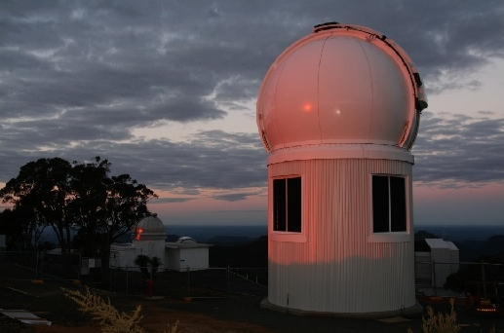
SkyMapper SN Team
Spectroscopic Pipeline and Follow-up – Mike Childress
Photometric Pipeline and Follow-up – Richard Scalzo and Fang Yuan
Sugar Daddy / Godfather – Brian Schmidt
Pitch Hitter / Jack-of-all-Trades – Brad Tucker

Slide 6
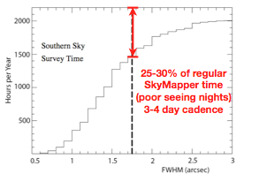
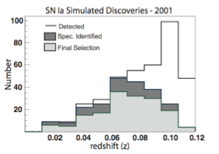
SkyMapper SN Search
Worst Seeing (>2”) ~ 30% of the time
~100 SN Ia up to z~0.1, 50 CC SN
Spectroscope follow-up with WiFeS

Slide 7
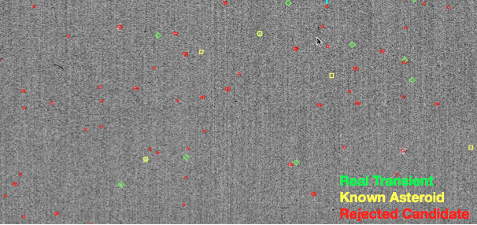
SkyMapper Pipeline

Slide 8
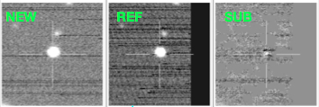
Spurious Detections

Slide 9
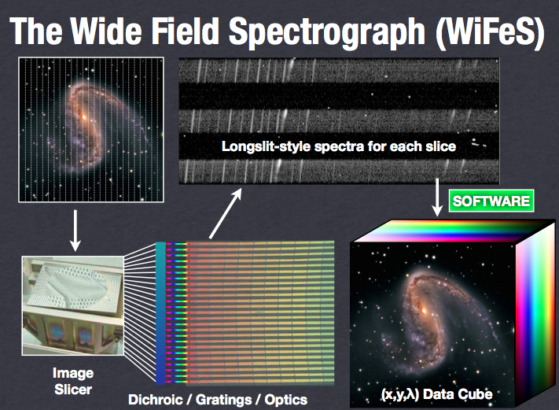
The Wide Field Spectograph (WiFeS)

Slide 10
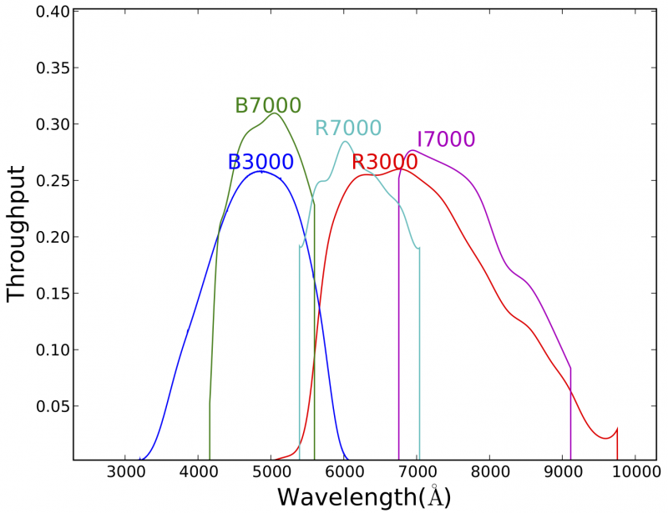
WiFeS Filters

Slide 11
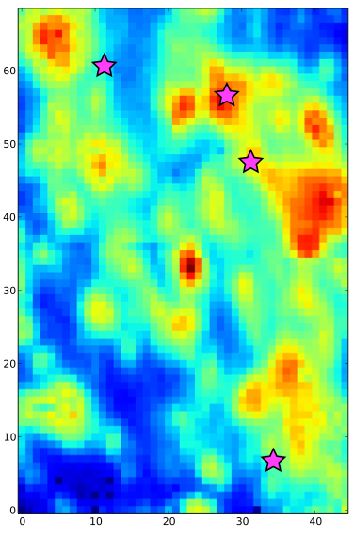
Galaxy Maps
NGC 1084

Slide 12
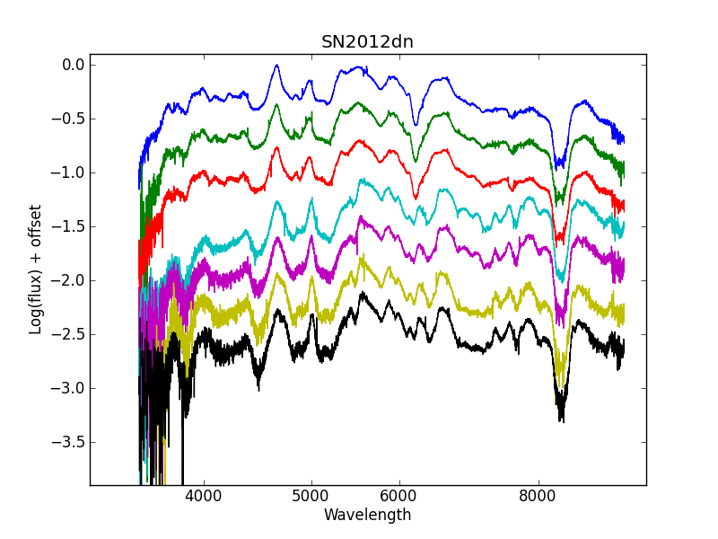
SN 2012dn

Slide 13
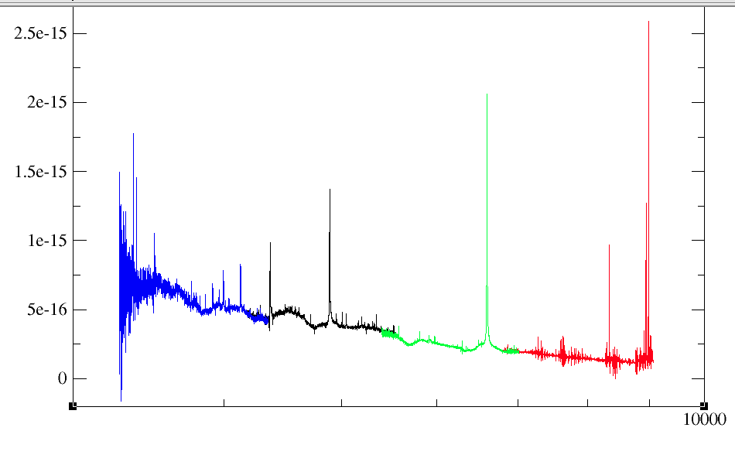
SN 2009ip

Slide 14
SN 2009ip

Slide 15
SN 2009ip

Slide 16
SN 2009ip

Slide 17
SN 2009ip

Slide 18
SN 2009ip

Slide 19
Always looking for targets for WiFeS so send them to us!

